Slide 1
Parallel Patterns

Slide 2
Reduction Operation

Slide 3
Reduction Operation
A reduction operation reduces a set of values to a single value
Sum, Product, Minimum, Maximum are examples
Properties of reduction
Associativity
Commutativity
Identity value
Reduction is a key primitive for parallel computing
E.g., MapReduce programming model
Dean and Ghemawat, “MapReduce: Simplified Data Processing of Large Clusters,” OSDI 2004
Notes:
A reduction is an operation that condenses a set of values into a single value, utilizing a specific operator such as product, minimum, maximum, or others. This operator must possess certain properties, including associativity, commutativity, and an identity value. It is commutative because we can interchange the elements being added. Additionally, its identity value is zero since adding zero to any value yields the original value. Reduction is a crucial primitive in parallel computing, and it is utilized in the map-reduce programming model.

Slide 4
Sequential Reduction
A sequential implementation of reduction only needs a for loop to go through the whole input array
N elements → N iterations
Many independent operations
A parallel implementation can calculate multiple partial sums, and then reduce them
sum = 0; // Initialize with identity value
for(i = 0; i < N; ++i) {
sum += A[i]; // Accumulate elements of input array A[]
}
Notes:
The implementation of sequential reduction only requires a for loop to iterate through the entire input array, which contains n elements, thus requiring n iterations. Therefore, the time complexity of a sequential reduction is O(n). In the case of the input array with n elements ranging from a0 to an-1, a straightforward code can perform the sequential reduction. The code initializes an accumulator with the identity value, which is zero since the reduction is using addition. The for loop then accumulates the values of all the elements in the input array into the accumulator. After the iterations are complete, the sum variable will hold the reduction result. Since the addition operations in the for loop are independent, a parallel implementation can compute multiple partial sums and then reduce them. By dividing the computation, multiple threads can perform many operations independently.

Slide 5
Tree-Based Reduction
Iteration 1
Partial results in temporary storage
Iteration 2
Iteration 3
Iteration 4
log(N) iterations
Notes:
The most common pattern for reduction is tree-based reduction. This method performs reduction in successive iterations, where each iteration assigns two elements to a single worker or thread that performs their addiction. In the first iteration, every two elements are assigned to threads, and their addition generates partial results that are stored in temporary storage. In the next iteration, half of the workers or threads retire, and the remaining workers or threads continue performing additions, accumulating partial results in temporary storage. This process continues until the third iteration, where only two values are left to add. In the final iteration, a single thread performs the final sum.

Slide 6
Tree-Based Reduction on GPU
Block 0
Block 1
Warp 0
Warp 1
Warp 0
Warp 1
Partial results in shared memory
(or registers)
Intra-block synchronization
__syncthreads();
Intra-block synchronization
__syncthreads();
Inter-block synchronization
Kernel termination and
Final reduction on CPU, or
Launch new reduction kernel on GPU
Atomic operations in global memory
Notes:
The tree-based reduction is the method used to implement reduction on a GPU. The input array is divided into available thread blocks, with computation assigned to threads and work inside each thread block. The threads perform partial additions in the first iteration and store the partial results in temporary storage. Intra-block synchronization is required for threads belonging to different works but in the same thread block that are writing to shared memory. After two iterations, two more values are left to add in each thread block, requiring one more intra-block synchronization. The final result is obtained as a single value per thread block, which can be accumulated into a global variable using atomic operations in global memory or by launching a new reduction kernel on the GPU.

Slide 7
Vector Reduction: Naïve Mapping (I)
Thread 0
Thread 2
Thread 4
Thread 6
Thread 8
Thread 10
0
1
2
3
4
5
6
7
8
9
10
11
…
1
0+1
2+3
4+5
6+7
8+9
10+11
2
0...3
4..7
8..11
iterations
3
0..7
8..15
Slide credit: Hwu & Kirk
Notes:
In the vector reduction, every active thread performs the addition of two values in each iteration. One way to optimize this process is to assign even number threads to perform the addition of two sums, such as thread zero adding element zero and one, thread two adding element two and three, and so on. In the next iteration, half of the threads retire, and the remaining threads perform additions of partial results. This process continues until the final iteration, where the last addition is performed.

Slide 8
Divergence-Free Mapping (I)
All active threads belong to the same warp
Thread 0
Thread 1
Thread 2
…
Thread 14
Thread 15
0
1
2
3
…
13
14
15
16
17
18
19
1
0+16
15+31
2
iterations
3
Slide credit: Hwu & Kirk
Notes:
We can use a divergence-free mapping technique that keeps active threads belonging to the same work or warp. Instead of assigning computation to odd or even number threads, we assign it to threads with lower thread IDs. For example, if we have 16 threads, we can assign the first 16 threads with the lowest IDs to perform the additions. Thread zero adds element zero and element 16, thread one adds element one and element 17, and so on. This mapping technique does not change the final result of the reduction since addition is associative and commutative. As the iterations progress, half of the threads retire, but the remaining threads belong to the same warp or warps, resulting in improved computational density utilization.

Slide 9
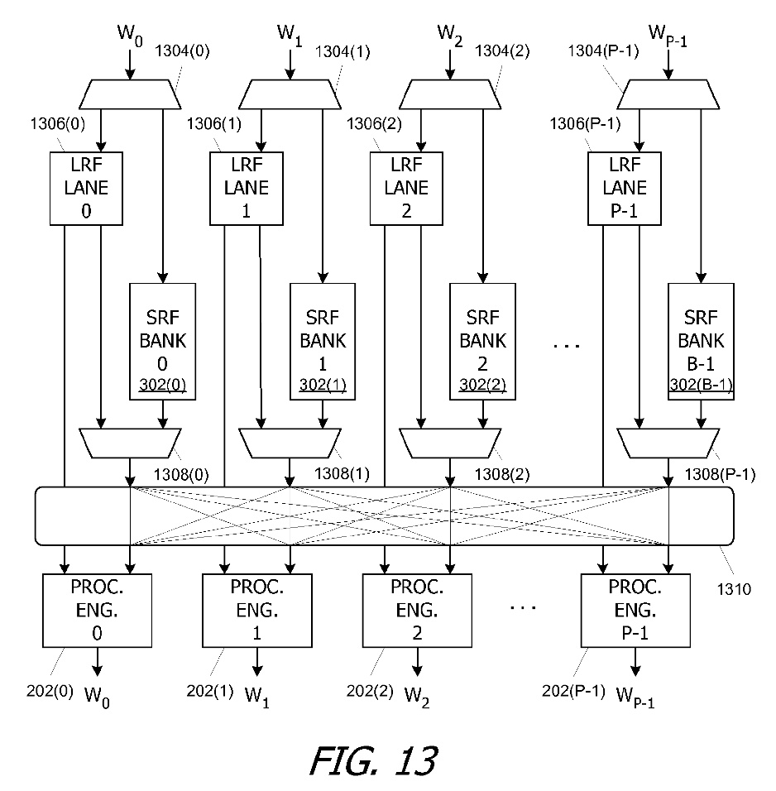
Read and Write Access to GPU Shared Memory
Threads running on processing engines have access to a local register file (LRF)
And shared memory banks (SRF)
Nickolls et al., "Single Interconnect Providing Read and Write Access to a Memory Shared by Concurrent Threads," US7680988B1
Notes:
Although the implementation details of functions in GPU hardware are not publicly known, we can speculate how they are implemented based on patterns provided by GPU manufacturers, such as Nvidia. For example, a pattern from Nvidia explains how to access shared memory using concurrent threads, and we can identify processing engines, shared memory banks, and local register files in the hardware. The register files are partitioned and assigned to different processing engines and threads, allowing for efficient read and write operations.

Slide 10
Read from Shared Memory Bank
Nickolls et al., "Single Interconnect Providing Read and Write Access to a Memory Shared by Concurrent Threads," US7680988B1
Notes:
To access shared memory, a processing engine in the GPU would perform a read operation to retrieve an element from a shared memory bank and write it to its own register in the local register file (LRF). The processing engine would request access to the shared memory bank that contains the desired element through a crossbar interconnect that connects the processing engine to the shared memory bank.

Slide 11
Write to Shared Memory Bank
Nickolls et al., "Single Interconnect Providing Read and Write Access to a Memory Shared by Concurrent Threads," US7680988B1
Notes:
The element is then moved to the register file using the interconnect, allowing the processing engine to access the value from shared memory. Similarly, to write a value to a shared memory bank, a processing engine would first have a value in its LRF and then use the interconnect to write it to the corresponding shared memory bank.

Slide 12
Shuffling Operations within a Warp
Nickolls et al., "Single Interconnect Providing Read and Write Access to a Memory Shared by Concurrent Threads," US7680988B1

Slide 13
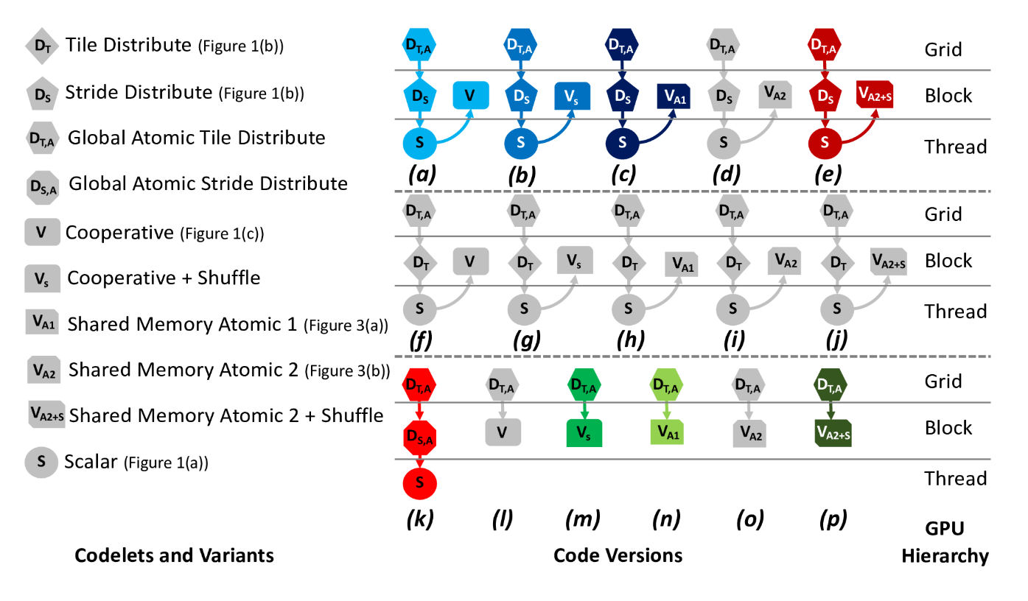
Search Space of Parallel Reduction
Over 85 different versions possible!
Garcia de Gonzalo et al., “Automatic Generation of Warp-Level Primitives and Atomic Instructions for Fast and Portable Parallel Reduction on GPUs,” CGO 2019
Notes:
To find the most efficient implementation of parallel reduction, we explored various combinations of atomic operations to shared memory, atomic operations to global memory, shuffle instructions, and other techniques. We tested up to 85 different versions on different architectures to determine the most effective methods for performing reduction at various levels of the software, such as the grid, block, and thread levels.

Slide 14
Histogram Computation

Slide 15
Histogram Computation
Histogram is a frequently used computation for reducing the dimensionality and extracting notable features and patterns from large data sets
Feature extraction for object recognition in images
Fraud detection in credit card transactions
Correlating heavenly object movements in astrophysics
…
Basic histograms - for each element in the data set, use the value to identify a “bin” to increment
Divide possible input value range into “bins”
Associate a counter to each bin
For each input element, examine its value and determine the bin it falls into and increment the counter for that bin
Slide credit: Hwu & Kirk
Notes:
A histogram is a commonly used method to reduce the dimensionality of large datasets and extract notable patterns and features, frequently utilized in image processing for feature extraction, fraud detection, and many other fields. In its simplest form, a histogram involves iterating over each element in the input dataset and identifying which bin it belongs to based on its value. The histogram consists of a fixed number of bins, each with an associated counter. After determining the appropriate bin, the corresponding counter is incremented, typically by adding one. This process is commutative and associative, so it can be performed in various ways. Sequential implementation of histogram computation involves iterating over all the elements of the input array, checking the value, determining the corresponding bin, and updating its counter.

Slide 16
Sequential Histogram Computation
A sequential implementation of histogram computation reads all input elements one by one and updates the corresponding histogram bins
I
_
C
A
L
C
U
L
A
T
E
_
A
_
H
I
S
T
O
G
R
A
M
Iteration 1
Thread 0
Iteration 2
Iteration 3
Iteration 4
1
1
1
1
_
A
B
C
D
E
F
G
H
I
J
K
L
M
N
O
P
Q
R
S
T
U
V …
Notes:
In order to compute a histogram, we need to go over all elements in the input data set, identify the bin that we have to increment based on the value of the element, and then update the corresponding histogram. The histogram is essentially a set of counters associated with each bin. A sequential reduction can be performed by going over all the elements of the input array, identifying the corresponding bin, and incrementing its counter. A sample histogram for the sentence "I calculate a histogram" is shown at the bottom, where each possible character is a bin and its corresponding counter is the number of occurrences of that character in the sentence.

Slide 17
Sequential Histogram Function
void histogram_calculation(unsigned int *histo,
unsigned int *input,
unsigned int input_size){
int i = 0; // Loop index
while(i < input_size){
unsigned int val = input[i];
histo[val] += 1;
i++;
}
}
Notes:
The code for a sequential histogram function is simple, requiring only iteration over all the elements of the input array and incrementing the corresponding bin of the histogram.

Slide 18
Parallel Histogram Computation: Iteration 1
Adjacent threads read adjacent input characters
Reads from the input array are coalesced
I
_
C
A
L
C
U
L
A
T
E
_
A
_
H
I
S
T
O
G
R
A
M
Thread 0
Thread 1
Thread 2
Thread 3
1
1
1
1
_
A
B
C
D
E
F
G
H
I
J
K
L
M
N
O
P
Q
R
S
T
U
V …
Notes:
However, to implement this in parallel, multiple threads can read different input elements at the same time and update the output histogram. The parallel implementation requires a GPU kernel to define an index based on the block ID and thread ID for accessing the input array and updating the corresponding histogram bin.

Slide 19
(Wrong) Parallel Histogram Kernel
__global__ void histogram_kernel(unsigned int *histo,
unsigned int *input,
unsigned int input_size){
int i = blockIdx.x * blockDim.x + threadIdx.x; // Thread index
int stride = blockDim.x * gridDim.x; // Total number of threads
while(i < input_size){
unsigned int val = input[i];
histo[val] += 1;
i += stride;
}
}
Notes:
But conflicts can arise when multiple threads attempt to update the same bin, causing atomic conflicts or data race.

Slide 20
Parallel Histogram Computation: Iteration 2
All threads move to the next section of the input
Each thread moves to element threadID + #threads
I
_
C
A
L
C
U
L
A
T
E
_
A
_
H
I
S
T
O
G
R
A
M
Thread 0
Thread 1
Thread 2
Thread 3
We need to use atomic operations
1
1
2
1
1
2
1
_
A
B
C
D
E
F
G
H
I
J
K
L
M
N
O
P
Q
R
S
T
U
V …
Notes:
To avoid this, the parallel code needs to use atomic operations to perform a read-modify-write operation to the corresponding bin of the histogram.

Slide 21
(Correct) Parallel Histogram Kernel
__global__ void histogram_kernel(unsigned int *histo,
unsigned int *input,
unsigned int input_size){
int i = blockIdx.x * blockDim.x + threadIdx.x; // Thread index
int stride = blockDim.x * gridDim.x; // Total number of threads
while(i < input_size){
unsigned int val = input[i];
histo[val] += 1;
i += stride;
}
}
atomicAdd(&histo[val], 1);

Slide 22
Atomic Operations on DRAM
Each Load-Modify-Store has two full memory access delays
All atomic operations on the same variable (RAM location) are serialized
time
internal routing
internal routing
DRAM delay
DRAM delay
DRAM delay
transfer delay
transfer delay
atomic operation N
atomic operation N+1
Slide credit: Hwu & Kirk
Notes:
One potential issue with atomic operations is that they may cause serialization of execution, which can be extremely costly if the operations occur directly in global memory. This is because global memory is DRAM and it takes a long time to fetch, transfer, and write back data. Even a small number of atomic operations performed by different threads on the same global memory location can incur significant data movement delays and latency.

Slide 23
Hardware Improvements
Atomic operations on Fermi L2 cache
Medium latency, but still serialized
Global to all blocks
“Free improvement” on Global Memory atomics
time
internal routing
data transfer
data transfer
atomic operation N
atomic operation N+1
Slide credit: Hwu & Kirk
Notes:
However, hardware improvements such as those in the Fermi architecture have improved the execution of atomic operations in global memory.The atomic operations performed directly in global memory may be extremely costly because of the delays caused by data movement from the global memory to the processor and vice versa, as well as the serialization of execution.

Slide 24
Hardware Improvements (Cont.)
Atomic operations on Shared Memory
Very short latency, but still serialized
Private to each thread block
Need algorithm work by programmers (more later)
time
internal routing
data transfer
..
atomic operation N
atomic operation N+1
Slide credit: Hwu & Kirk
Notes:
The Fermi architecture improved the execution of atomic operations by allowing them to be performed directly in the L2 cache, but this is still relatively far from the core and incurs high latency. An alternative way to improve performance is to perform the atomic operations on shared memory, which is closer, but this requires modifications to the algorithm and work from the programmers.

Slide 25
Image Histogram
Histograms are widely used in image processing
Some computation before voting in the histogram may be needed
Parallel threads frequently incur atomic conflicts in image histogram computation
For (each pixel i in image I){
Pixel = I[i] // Read pixel
Pixel’ = Computation(Pixel) // Optional computation
Histogram[Pixel’]++ // Vote in histogram bin
}
Notes:
The use of histograms in image processing is common and involves reading pixels from an input image, performing computations, obtaining values, indexing the histogram with these values, and updating the corresponding histogram. This process can be done sequentially or in parallel, but care must be taken to avoid conflicts that require the use of atomic operations.

Slide 26
Histogram Computation of Natural Images
Frequent atomic conflicts due to the spatial similarity of the pixel value distribution in natural images
By using multiple sub-histograms (which are merged at the end), we can reduce the frequency of atomic conflicts
This optimization technique is called privatization
Notes:
The atomic conflicts can be frequent in natural images due to the similarity of the pixel values. For instance, the pixels in the forehead of a woman can have the same values, which causes an atomic conflict when the same warp threads read and update corresponding histogram bins. To address this issue, multiple subhistograms can be used, which reduces the frequency of atomic conflicts. By generating more bins, different threads can update different subhistograms to avoid conflicts. This technique is called privatization.

Slide 27
Optimizing Histogram Computation
Multiple private sub-histograms per block
+ padding to avoid conflicts on banks and lock bits
Gomez-Luna+, “An Optimized Approach to Histogram Computation on GPU,” MVAP, 2013
Notes:
The atomic operations can work in shared memory and the optimization technique called privatization proposes using multiple private subhistograms per block. This optimization can be taken further by using multiple private subhistograms per block instead of using only one. These subhistograms can update the same shared memory being in different superhistograms to avoid position conflicts. However, there can still be bank conflicts and log conflicts, so padding can be used to shift the mapping of the superhistogram on the shared memory. Results on older GPU architectures show a significant performance improvement with an increased replication factor or privatized copies and padding.

Slide 28
Convolution

Slide 29
Convolution and its Applications
Convolution is a widely-used operation in signal processing, image processing, video processing, and computer vision
Convolution applies a filter or mask or kernel* on each element of the input (e.g., a signal, an image, a frame) to obtain a new value, which is a weighted sum of a set of neighboring input elements
Smoothing, sharpening, or blurring an image
Finding edges in an image
Removing noise, etc.
Applications in machine learning and artificial intelligence
Convolutional Neural Networks (CNN or ConvNets)
* The term “kernel” may create confusion in the context of GPUs (recall a CUDA/GPU kernel is a function executed by a GPU)
Notes:
convolution is widely used in signal processing, image processing, video processing, and computer vision. Convolution applies a filter or mask on each element of the input to obtain a weighted sum of the set of neighboring input elements, which corresponds to the element in the output. We will use the terms filter or mask instead of kernel to avoid confusion with the functions executed on the GPU called kernels. Convolution is used for smoothing, sharpening, blurring, finding edges, and removing noise in image processing. In machine learning and artificial intelligence, convolution is essential for convolutional neural networks or comments, where the convolutional layers are the most important ones.

Slide 30
1D Convolution Example
Commonly used for audio processing
Mask size is usually an odd number of elements for symmetry (5 in this example)
Calculation of P[2]:
N
N[0]
N[1]
N[2]
N[3]
N[4]
N[5]
N[6]
P
P[0]
P[1]
P[2]
P[3]
P[4]
P[5]
P[6]
1
2
3
4
5
6
7
3
8
57
16
15
3
3
Sum
M
M[0]
M[1]
M[2]
M[3]
M[4]
3
8
15
16
15
3
4
5
4
3
Partial products
Slide credit: Hwu & Kirk
Notes:
In 1D convolution, a mask is applied to each element of the input array to obtain a new value in the corresponding element of the output array. This type of convolution is used in audio processing, where the input signal is one-dimensional. The mask size is typically an odd number for symmetry, and to calculate an output element, the mask is centered on the corresponding input element, and partial products are obtained by multiplying each input element with the corresponding mask element. These partial products are then summed up to obtain the output element. For example, to calculate the element p2, the mask is placed on top of the element n2, partial products are obtained, and then added up to get the value of p2.

Slide 31
1D Convolution Example: Next Element
Calculation of P[3]
N
N[0]
N[1]
N[2]
N[3]
N[4]
N[5]
N[6]
P
P[0]
P[1]
P[2]
P[3]
P[4]
P[5]
P[6]
1
2
3
4
5
6
7
3
8
57
76
16
15
3
3
Sum
M
M[0]
M[1]
M[2]
M[3]
M[4]
6
12
20
20
18
3
4
5
4
3
Partial products
Slide credit: Hwu & Kirk
Notes:
The next step is to calculate the next element of the output, which is p3. We repeat the process by placing the mask on top of element n3 and performing the multiplication of each element of n with each element of the mask m, which results in partial products. We then reduce these partial products by summing them up to get the value of p3.

Slide 32
1D Convolution Boundary Condition
Calculation of output elements near the boundaries (beginning and end) of the input array need to deal with “ghost” elements
Different policies (0, replicates of boundary values, etc.)
N
N[0]
N[1]
N[2]
N[3]
N[4]
N[5]
N[6]
P
P[0]
P[1]
P[2]
P[3]
P[4]
P[5]
P[6]
0
1
2
3
4
5
6
7
3
8
38
16
15
3
3
Sum
M
M[0]
M[1]
M[2]
M[3]
M[4]
0
4
10
12
13
3
4
5
4
3
Partial products
Slide credit: Hwu & Kirk
Notes:
When computing an element near the boundary of the input array, ghost elements need to be taken care of. These elements don't exist in the input array but need to be assigned values, which can be either zero or the replicated boundary values. In the given example, zero is used as the ghost element when calculating p1. The code for the 1D convolution kernel with boundary condition handling is also shown.

Slide 33
Storing the Mask in Constant Memory
We can store the mask in constant memory
The mask is small
It is constant
It is accessed by all threads
Constant memory is cached inside each GPU core and it is particularly fast when all threads of a warp access the same value
1. Declare the mask as a global variable
#define MASK_WIDTH 5
__constant__ float M[MASK_WIDTH];
2. Initialize the mask from the host
cudaMemcpyToSymbol(M, M_h, Mask_Width*sizeof(float));
Destination
Source
Size
Notes:
To store the mask, we can use constant memory, since the mask is small, constant, and accessed by all threads running on the GPU core. In this specific example of convolution, constant memory is cached inside each CUDA core and is particularly fast when all threads of a warp access the same value. By declaring the mask as a global variable and using the constant qualifier, we can initialize the mask from the host using cudaMemcpyToSymbol(), which copies m_h from the main memory of the host processor to the destination m in constant memory, with a size of mask_width * sizeof(float).

Slide 34
Recall: Data Reuse: Tiling
To take advantage of data reuse, we divide the input into tiles that can be loaded into shared memory
__shared__ int l_data[(L_SIZE+2)*(L_SIZE+2)];
…
Load tile into shared memory
__syncthreads();
for (int i = 0; i < 3; i++){
for (int j = 0; j < 3; j++){
sum += gauss[i][j] * l_data[(i+l_row-1)*(L_SIZE+2)+j+l_col-1];
}
}
Notes:
The convolution has many threads that share data, which leads to data reusing, and this can be solved by using tiling. Tiling is a technique that can be used to solve this problem. It was previously introduced in previous lectures in a two-dimensional organization using shared memory, and it is similar for the convolution. The basic idea of the 1D convolution is used to demonstrate how to apply tiling in the convolution process.

Slide 35
Tiled 1D Convolution Basic Idea
Block 0
Block 1
Block 2
Block 3
P
0
1
2
3
4
5
6
7
8
9
10
11
12
13
14
15
N
0
1
2
3
4
5
6
7
8
9
10
11
12
13
14
15
Tile 0
ghost
0
1
2
3
4
5
Tile 1
2
3
4
5
6
7
8
9
halo
Tile 2
6
7
8
9
10
11
12
13
Tile 3
10
11
12
13
14
15
ghost
Slide credit: Hwu & Kirk
Notes:
We have to divide the output array P into equally sized blocks, which are assigned to different thread blocks. We assume that each thread block contains four threads. Now, we need to compute the output elements of P by using a tile that each of the thread blocks needs. For example, for block 0, we would use tile 0. However, in order to compute some output elements, we also need to use some elements of the input that belong to other thread blocks, which are called hollow elements. To load the whole tile including the hollows into shared memory, we can achieve better performance. We should declare a shared memory tile array and each thread block loads the corresponding chunk of input into this shared memory tile array.

Slide 36
2D Convolution (I)
The mask is 2D
For example, a Gaussian filter
Gaussian mask
Notes:
The 2D convolution is similar to 1D convolution and is widely used in image processing. A 2D mask is used in this case since the input is two-dimensional. Gaussian filter is an example of a 2D convolution. Tiling is used in 2D convolution as well to take advantage of data reuse.

Slide 37
2D Convolution (II)
Same memory locations accessed by neighboring threads
for (int i = 0; i < 3; i++){
for (int j = 0; j < 3; j++){
sum += gauss[i][j] * Image[(i+row-1)*width + (j+col-1)];
}
}

Slide 38
Tiling in 2D Convolution
To take advantage of data reuse, we divide the input into tiles that can be loaded into shared memory
__shared__ int l_data[(L_SIZE+2)*(L_SIZE+2)];
…
Load tile into shared memory
__syncthreads();
for (int i = 0; i < 3; i++){
for (int j = 0; j < 3; j++){
sum += gauss[i][j] * l_data[(i+l_row-1)*(L_SIZE+2)+j+l_col-1];
}
}
Notes:
The tiles are loaded into shared memory and the computation is performed. Loading the tiles into shared memory can be done in various ways, one of which is similar to 1D convolution where the left hollow is loaded first, followed by the values in the middle, and then the right hollow.

Slide 39
Loading Tiles into Shared Memory
output tile dimension
input tile dimension
mask dimension
mask radius
input_{tile}
(in shared memory)
mask
(in constant memory)
output
Challenge: Input and output tiles have different dimensions
( input tile dimension = output tile dimension + 2 × mask radius )
Solution: Launch enough threads per block to load the input tile to shared memory, then use a subset of them to compute and store the output tile
Slide credit: Izzat El Hajj
Notes:
In two-dimensional convolution for image processing, the same memory locations are accessed by multiple threads, and tiling is used to take advantage of data reuse. Two-dimensional tiles are used for loading into shared memory, and the input and output tiles have different dimensions due to the mask used. The input tile dimension is equal to the output tile dimension plus two times the mask radius. The proposed solution is to launch enough threads for block to load the input tile into shared memory and then use a subset of them to perform the computation.

Slide 40
Difference in Tile Sizes (I)
output tile dimension
input tile dimension
mask dimension
mask radius
input_{tile}
(in shared memory)
mask
(in constant memory)
input tile dimension
output
thread block
Slide credit: Izzat El Hajj
Notes:
This is going to be the size of the thread block launched to execute on a GPU core. Note that the size of the thread block matches the size of the input tile dimension.

Slide 41
Difference in Tile Sizes (II)
output tile dimension
input tile dimension
mask dimension
mask radius
input_{tile}
(in shared memory)
mask
(in constant memory)
input tile dimension
output
threads active when loading input tile
thread block
Slide credit: Izzat El Hajj
Notes:
All threads are active such that each thread of the thread block is loading the corresponding element of the input into shared memory. After completing this loading into shared memory, we synchronize and then perform the actual computation.

Slide 42
Difference in Tile Sizes (III)
output tile dimension
input tile dimension
mask dimension
mask radius
input_{tile}
(in shared memory)
mask
(in constant memory)
input tile dimension
output tile dimension
output
threads active when computing and storing the output tile
thread block
Slide credit: Izzat El Hajj
Notes:
However, for the actual computation, we only use those threads that are on top of the output tile. In this example, we are only using 4x4 threads of the thread block to compute the output tile.

Slide 43

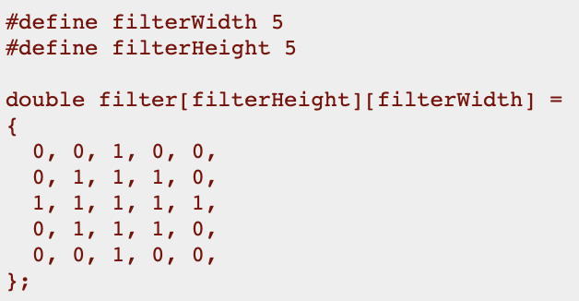

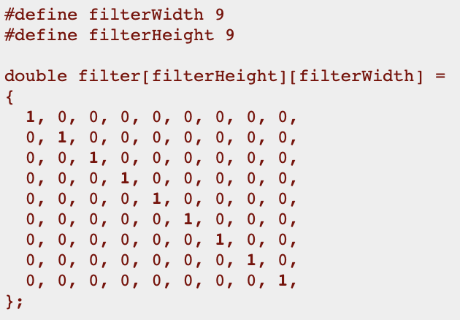


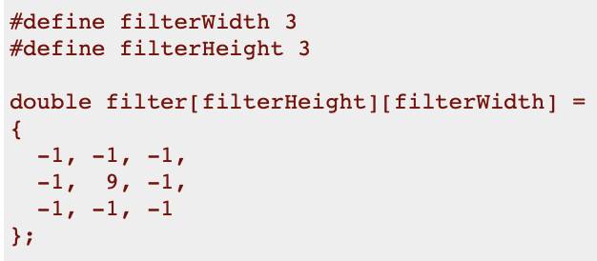
2D Convolution Examples
Original
Blur
Motion blur
Sharpen
https://lodev.org/cgtutor/filtering.html
Notes:
The examples given for 2D convolutions in image processing include applying a blur filter, motion blur filter, and sharpened filter to an original image.

Slide 44
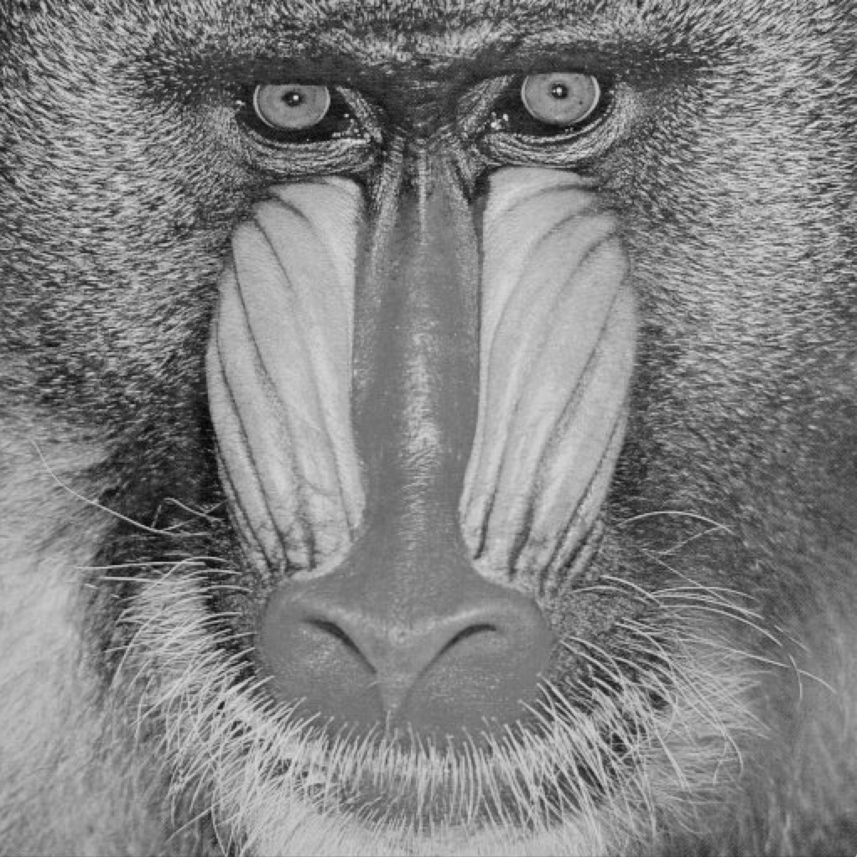
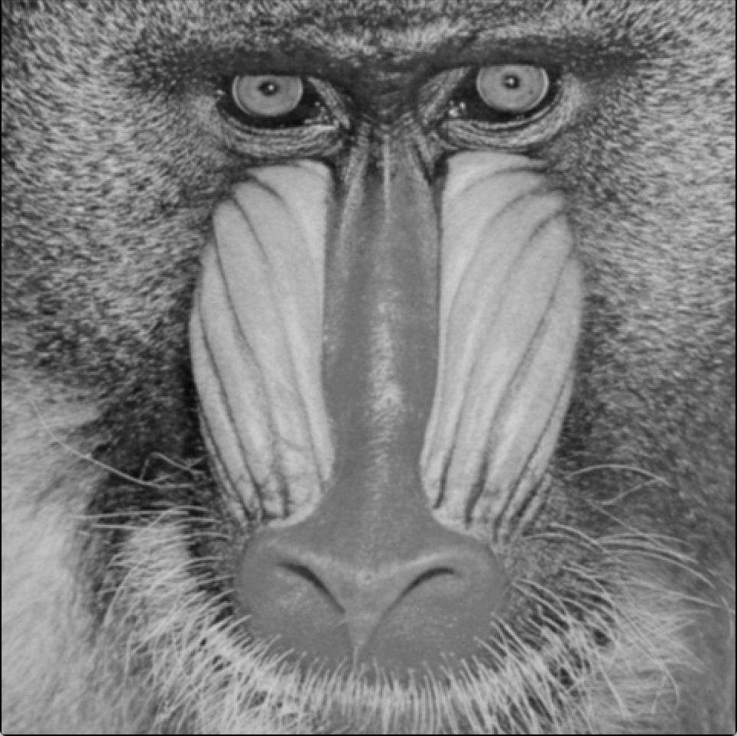
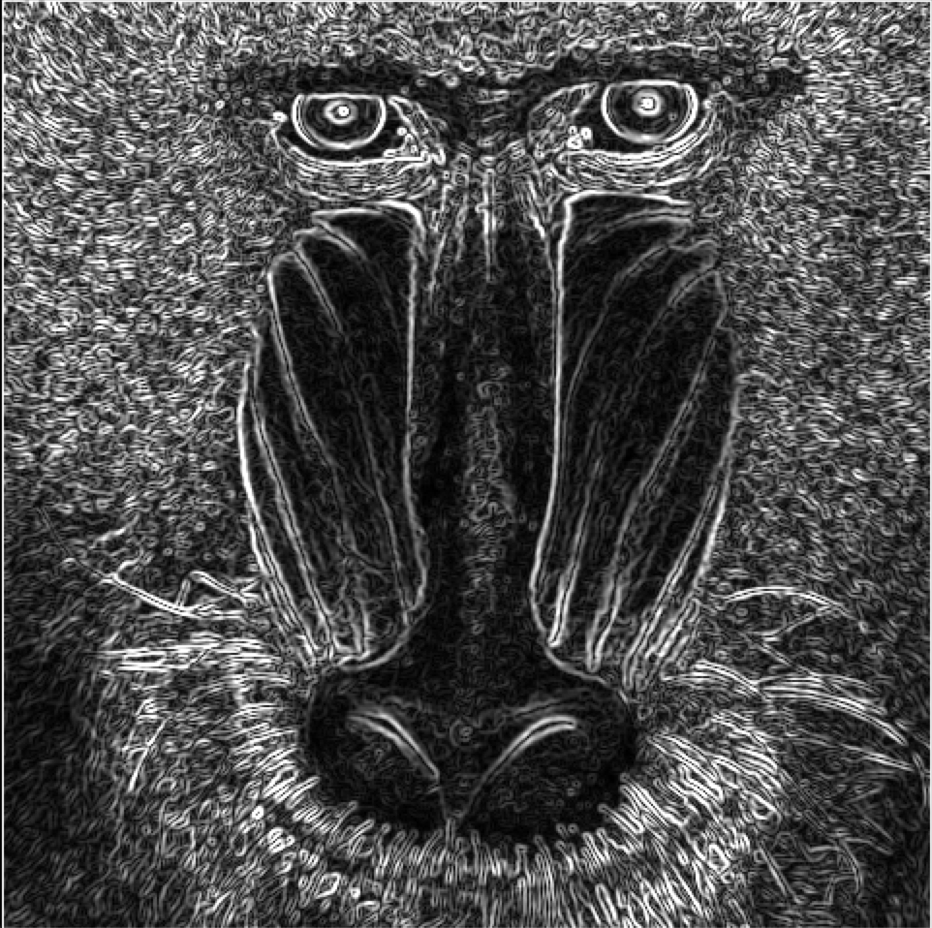
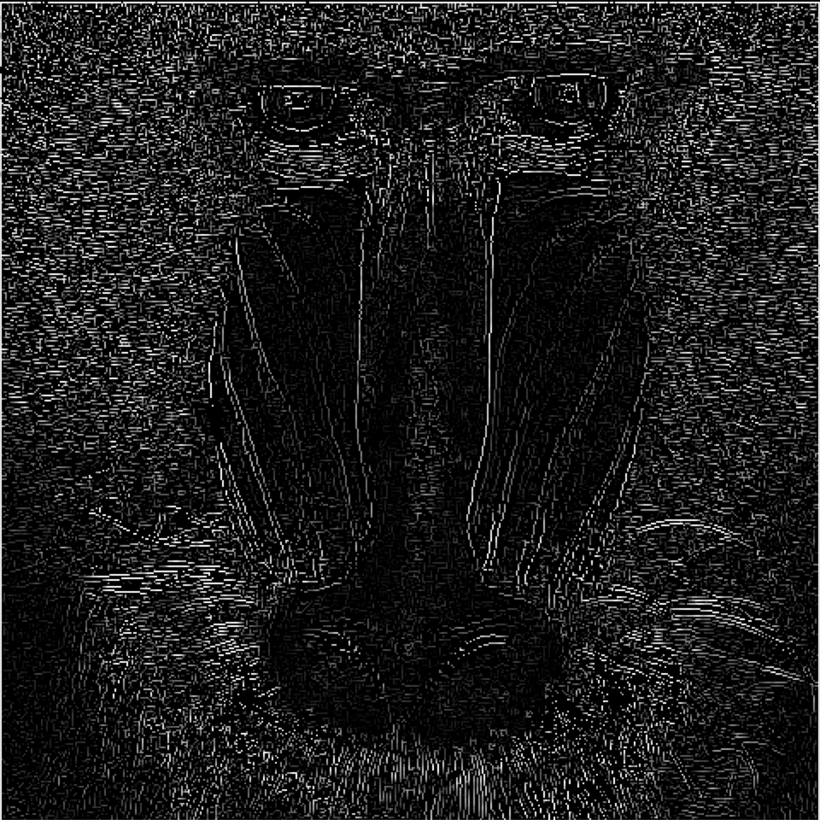
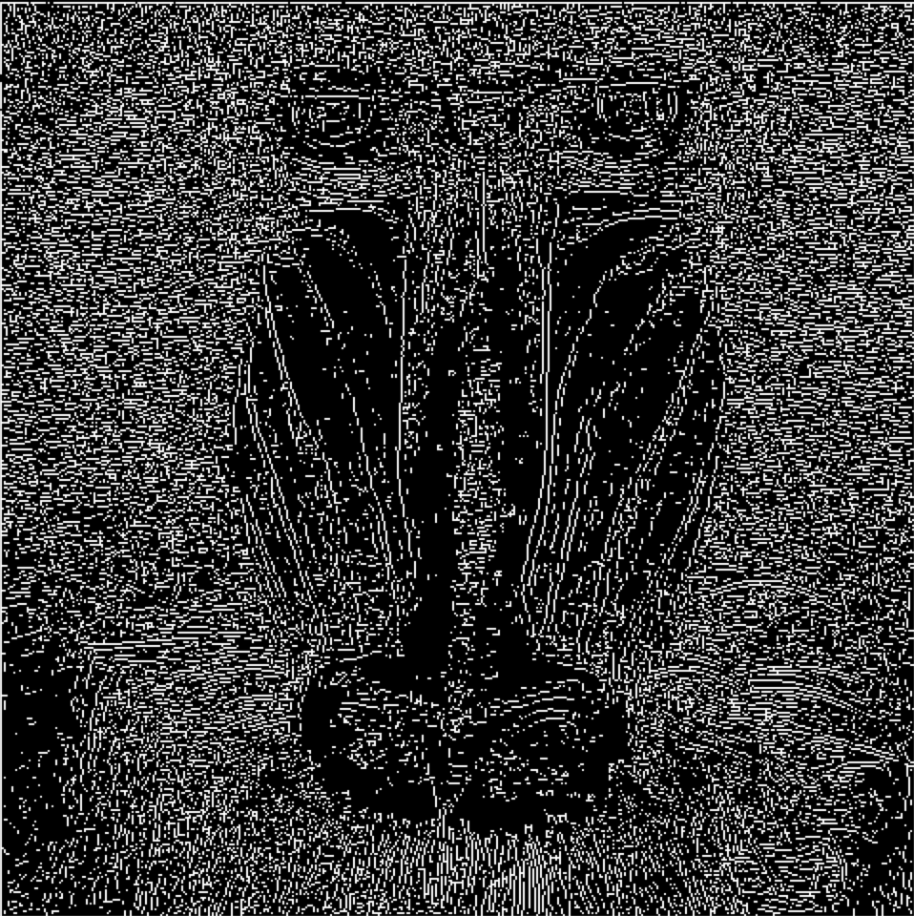
Canny Edge Detection
Gaussian filtering
Smooth the image to remove noise
Sobel filtering
Find the intensity gradients of the image
Non-maximum suppression
Suppress spurious response to edge detection
Hysteresis threshold
Strong edges + weak edges connected to a strong edge
Canny, "A Computational Approach To Edge Detection," IEEE TPAMI, 1986
Notes:
2D convolutions are widely used in image processing, including edge detection, with the Canny edge detection algorithm being a popular example. The Canny algorithm involves applying Gaussian filtering to smooth the image and remove noise, followed by a Sobel filter to find the intensity gradients. Non-maximum suppression is then used to suppress spurious edge detections, and finally, hysteresis thresholding is applied to select strong and weak edges connected to strong edges.

Slide 45
Convolutions are Stencils

Slide 46
Stencil Computation
Stencils are a class of algorithms where each output element is calculated from a set of neighboring input elements in a structured grid
Widely-used in high performance computing to solve partial differential equations (PDEs)
Notes:
Convolution is a fundamental computation that involves calculating output elements from a set of input elements using a structured grid and a filter. It is a special type of extensive computation, which is widely used in high-performance computing to solve partial differential equations. As the dimensionality of the stencils increases, the computations become more complex.

Slide 47
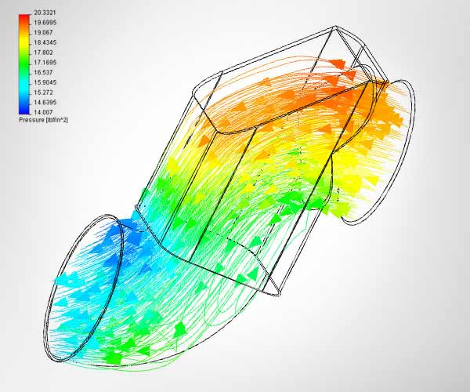


Stencil Computation and Applications
Stencil computations update values in a grid using a fixed pattern of grid points
Stencils are used in ~30% of high-performance computing applications
x
-,+,*
-,+,*
y
7-point Jacobi in 3D plane
http://www.flometrics.com/fluid-dynamics/computational-fluid-dynamics
Naoe et al., "Secure Key Generation for Static Visual Watermarking by Machine Learning in Intelligent Systems and Services," IJSSOE, 2010
Notes:
[CLICK] Stencil computations update values in a multidimensional grid using a fixed pattern of grid points
To demonstrate, we show a basic elementary 7-point 3D Jacobi stencil, which is frequently used as a benchmark for stencil study.
This kernel accesses 7 elements to perform six additions and two multiplications at the same time.
[CLICK] Stencils are widely used! Around 30% of high performance computing applications make use of different stencils
[CLICK] including fluid dynamics, [CLICK] image processing, [CLICK] atmospheric modeling, etc.
To update values in a grid using a fixed pattern of grid points, stencils are used in extensive computations. Stencils are a class of algorithms used in high-performance computing and are employed in around 30 applications including fluid dynamics simulation, edge detection in image processing, and climate modeling.

Slide 48
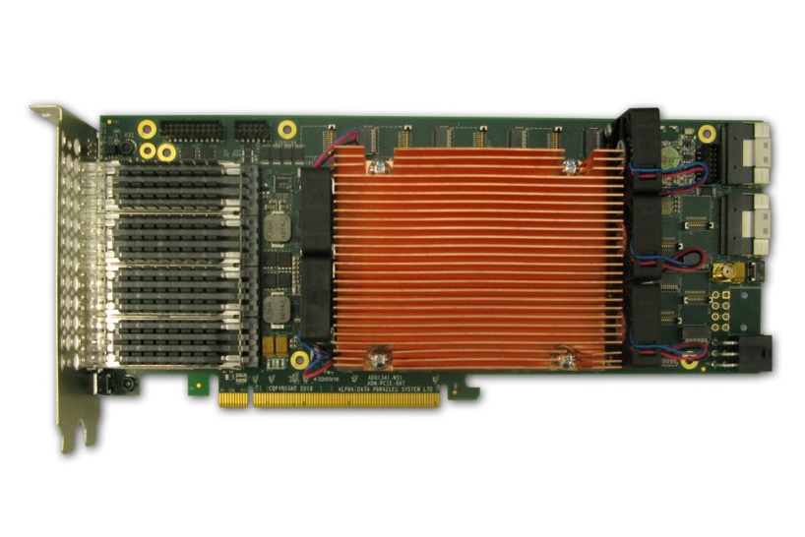
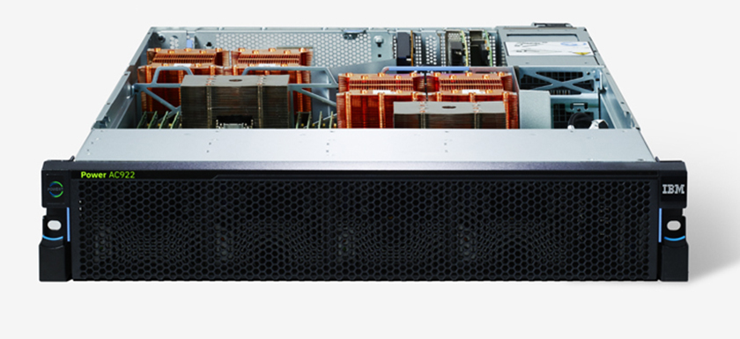
Heterogeneous System: CPU+FPGA
CAPI2
Source: IBM
Source: AlphaData
POWER9 AC922
HBM-based AD9H7 board
We evaluate two POWER9+FPGA systems:
1. HBM-based board AD9H7
Xilinx Virtex Ultrascale+™ XCVU37P-2
2. DDR4-based board AD9V3
Xilinx Virtex Ultrascale+™ XCVU3P-2
48
Singh et al., NERO: A Near High-Bandwidth Memory Stencil Accelerator for Weather Prediction Modeling, FPL 2020
Notes:
Our heterogeneous system comprises of IBM POWER9 CPU connected to an FPGA board via CAPI2 interface.
We used an inter-unit system with an IBM Power9 CPU and not with a GPU. The CPU was connected through CAPI, a coherent memory bus, to two different FPGAs with HPM memory or DDR4 memory. CAPI II is a coherent interface that enables easy data exchange between the CPU and the FPGA in a coherent manner.

Slide 49
Convolutions in Machine Learning

Slide 50
Convolutions in Machine Learning
Convolutions are traditionally used for feature detection in image processing
They can be used as neural network layers
Convolutions have an advantage over fully connected layers (e.g., in multilayer perceptron, MLP)
Local weights: They compute on only a window around the element of interest
Data sharing via on-chip memories is feasible
Fully connected layer
+
+
Convolutional layer
W₀
W₁
…
W₅
…
w_{0,0}
w_{0,1}
…
w_{1,0}
Weight sharing
x₀
x₁
…
x_{0,0}
x_{0,1}
…
x₅
…
x_{1,0}
…
…
…
Notes:
Convolutional layers are not only traditionally used for feature detection in image processing, but they can also be used as neural network layers. They have certain advantages compared to fully connected layers used in multi-layer perceptron neural networks. The reason is that fully connected layers require accessing all elements of the input and applying corresponding weights to compute each output element, while convolutional layers only use local weights and input elements surrounding the element of interest. As these weights are local, so they can be shared and placed in on-chip memories that are usually smaller.

Slide 51
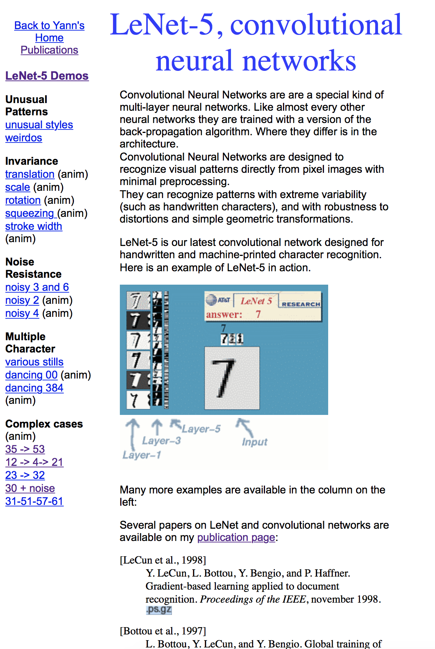

Convolutional Neural Networks: Demo
http://yann.lecun.com/exdb/lenet/index.html
Notes:
Convolutional neural networks have been proposed many years ago, and LeNet-5 is one of the earliest examples from Yann LeCun. These convolutional neural networks are designed to recognize visual patterns directly from pixels with minimal pre-processing.

Slide 52
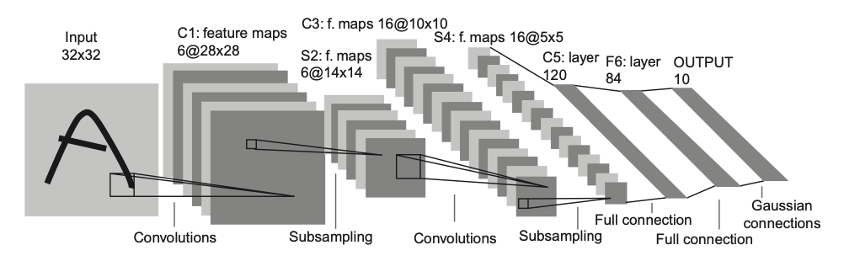
LeNet-5, a Convolutional Neural Network for Hand-Written Digit Recognition
This is a 1024*8 bit input, which will have a truth table of 2⁸¹⁹⁶ entries
Slide credit: Hwu & Kirk
Notes:
Another view of the Lenet5 architecture shows the different layers that make it up, including convolutional, sampling, and fully connected layers.

Slide 53

An Example of 2D Convolution
Output feature map
Structure information
Input: 5*5 (blue)
Kernel (filter): 3*3 (grey)
Output: 5*5 (green)
Computation information
Stride: 1
Padding: 1 (white)
Output Dim = (Input + 2*Padding - Kernel) / Stride + 1
Input feature map
Notes:
In a 2D convolution, the kernel is used to extract the two-dimensional information.
We usually use 3D convolution in image processing because we also need to extract the depth information.
Stride is the number of input values the kernel will jump when sliding on the input feature map. When stride = 1, the kernel moves to the adjacent input values without jumping.
The convolutional layers are complemented with sampling and fully connected layers in the Lenet5 network, and an example of a 2D convolution is illustrated with a blue input feature map, a green output feature map, and a three by three kernel that performs weighted multiplication and accumulation.
Padding is the number of zeros added outside the input feature map. Padding = 1 means adding a circle of zeros outside the input feature map.
The size of output can be calculated: Output = (Input + 2*Padding – Kernel) / Stride + 1
In this example: (5 + 2*1 – 3) / 1 + 1 = 5

Slide 54
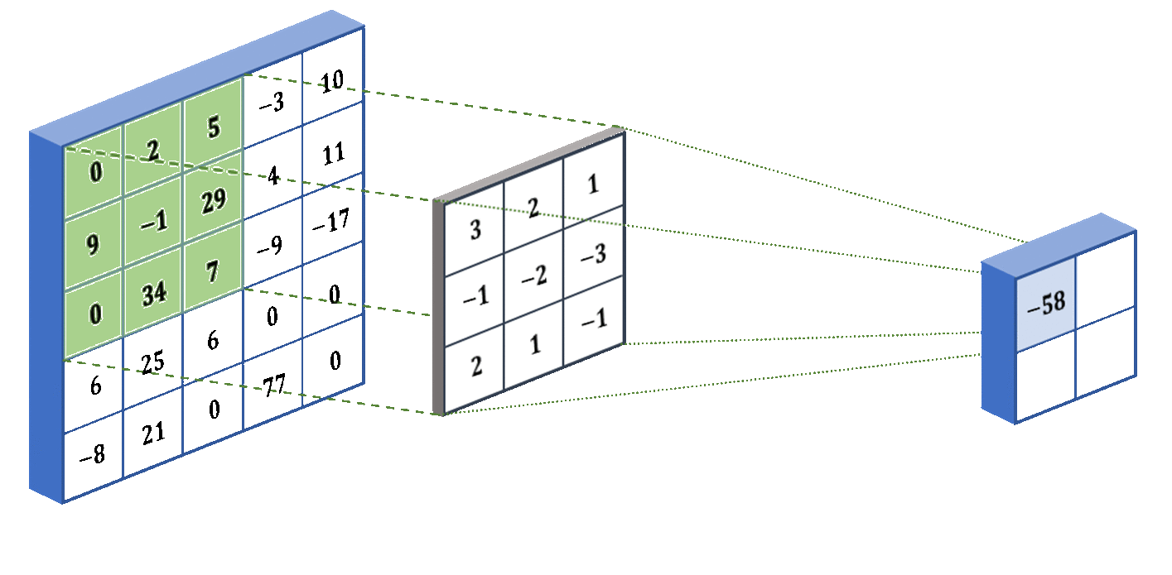
An Example of 2D Convolution
Input Layer
CNN filter
Output Layer
Notes:
Mark which layer is which -> first layer as input, second as kernel and last as output Another animation shows the application of a corresponding filter to the input feature map, resulting in the elements of the output layer. It is evident from this example and the previous one that applying filters or masks to the input feature maps also reduces the dimensionality of the output feature map.

Slide 55
Another Example of 2D Convolution
Input Layer
Output Layer
X
CNN filter
Y
1
2
3
4
5
6
7
1
2
3
4
5
W
2
3
4
5
6
2
3
4
5
6
7
8
1
2
3
2
1
3
4
5
6
7
8
9
2
3
4
3
2
3
4
321
6
7
4
5
6
7
8
5
6
3
4
5
4
3
4
5
6
7
8
2
3
4
3
2
5
6
7
8
5
5
6
7
8
5
6
7
1
2
3
2
1
6
7
8
9
0
1
2
7
8
9
0
1
2
3
1
4
9
8
5
Sum
Partial products
4
9
16
15
12
9
16
25
24
21
8
15
24
21
16
5
12
21
16
5
Slide credit: Hwu & Kirk
Notes:
The dimensions of the output feature map decrease due to the mask, and another example is presented where a CNN filter is applied to an input feature map. The computation is similar to 1D convolution, but input and output feature maps and masks are two-dimensional. The mask is applied to the input's elements, partial products are summed, and the result is obtained in the output feature map.

Slide 56
A Basic Conv. Layer Forward Kernel (Code is Incomplete!)
__global__ void ConvLayerForward_Basic_Kernel(int C, int W_grid,
int K, float* X, float* W, float* Y){
int m = blockIdx.x; // Index of the output feature map
int h = blockIdx.y / W_grid + threadIdx.y;
int w = blockIdx.y % W_grid + threadIdx.x;
float acc = 0.;
...
for(int c = 0; c < C; c++) { // Sum over all input channels
for(int p = 0; p < K; p++) // Loop over KxK filter
for(int q = 0; q < K; q++)
acc += X[c, h + p, w + q] * W[m, c, p, q];
}
Y[m, h, w] = acc;
}
Slide credit: Hwu & Kirk
Notes:
This code snippet demonstrates the basic implementation of a convolutional layer in a forward kernel for inference in a neural network. Although the code is incomplete, it provides a clear understanding of the process. The first step is to define the indices of the output feature map and use an accumulator. Then, the code loops over all channels of the input and output feature maps and applies a k by k filter to perform partial multiplications of each element of the input feature map with the corresponding element of the filter or mask. After summing these partial products, the accumulator is updated with the result at the corresponding location in the output feature map.

Slide 57
Reducing Convolution Layers to Matrix Multiplications
Convolution layers are the compute intensive parts of a CNN
GPUs have extremely high-performance implementations of matrix multiplications
Tiling techniques for matrix multiplication naturally reuse input features across output feature maps
Converting convolutions in a convolution layer to a matrix multiplication helps to keep the level of parallelism stable across CNN layers
Slide credit: Hwu & Kirk
Notes:
Convolutional layers are compute-intensive parts of CNNs that are well-suited for parallel processors like GPUs, but they can be made even more efficient by reducing them to matrix multiplications. GPUs are especially efficient at implementing high-performance matrix multiplication techniques, and there are techniques for matrix multiplications that naturally reuse input features across output feature maps. Converting convolutions in a convolution layer to matrix multiplication helps to maintain a stable level of parallelism across the CNN layers.

Slide 58
Implementing a Convolutional Layer with Matrix Multiplication
Slide credit: Reproduced from Hwu & Kirk
Notes:
The reduction of convolutional layers to matrix multiplication allows for better parallelism and more efficient processing on GPUs. The idea is to unroll the convolution filters and input features into matrices, which can be multiplied to obtain the output feature map. The process involves placing the input and filter elements into rows and columns of matrices, and then performing dot product operations to obtain the output feature map elements.

Slide 59
Tiled Matrix-Matrix Multiplication (I)
N
C = A x B
B
N
Step 1: Load the first tile of each input matrix to shared memory (each thread loads one element)
N
N
A
C
N
N
Slide credit: Izzat El Hajj
Notes:
One way to optimize matrix multiplication on GPUs is by using tiling, which involves loading different tiles of matrices A and B into shared memory and performing a multiplication of these submatrices while accumulating the corresponding tile of C.

Slide 60
Tiled Matrix-Matrix Multiplication (II)
B_{tile}
C_{tile} = A_{tile} x B_{tile}
Step 2: Each thread computes its partial sum from the tiles in shared memory (threads wait for each other to finish)
A_{tile}
C_{tile}
Slide credit: Izzat El Hajj
Notes:
This approach can be extended to hierarchical decomposition, where tiles of the matrix multiplication are first assigned to different processing elements, and each processing element further applies tiling to its assigned tile.

Slide 61
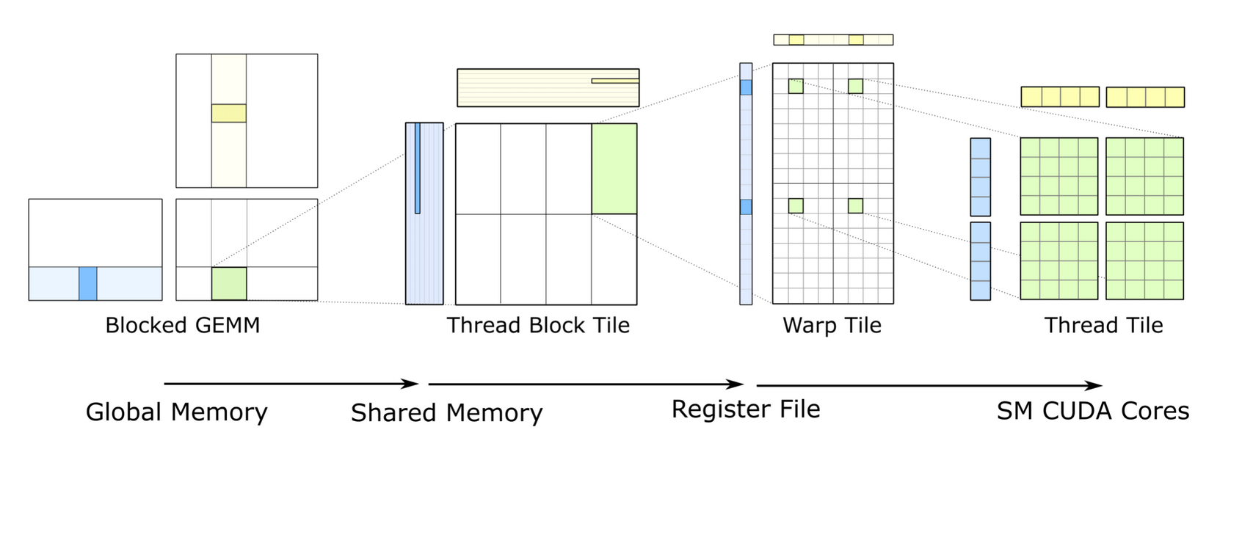
Deep Learning Matrix Multiplication Hierarchical Decomposition
https://www.anandtech.com/show/12673/titan-v-deep-learning-deep-dive/3
Notes:
One way to optimize matrix multiplication on GPUs is to use tiling, which involves dividing the matrices into smaller tiles and loading them into shared memory. The decomposition can be extended to divide the thread block tile into warp tiles and then further into smaller tiles assigned to individual threads. This allows for the use of register tiling, where the data is stored in registers to take advantage of faster access times.

Slide 62
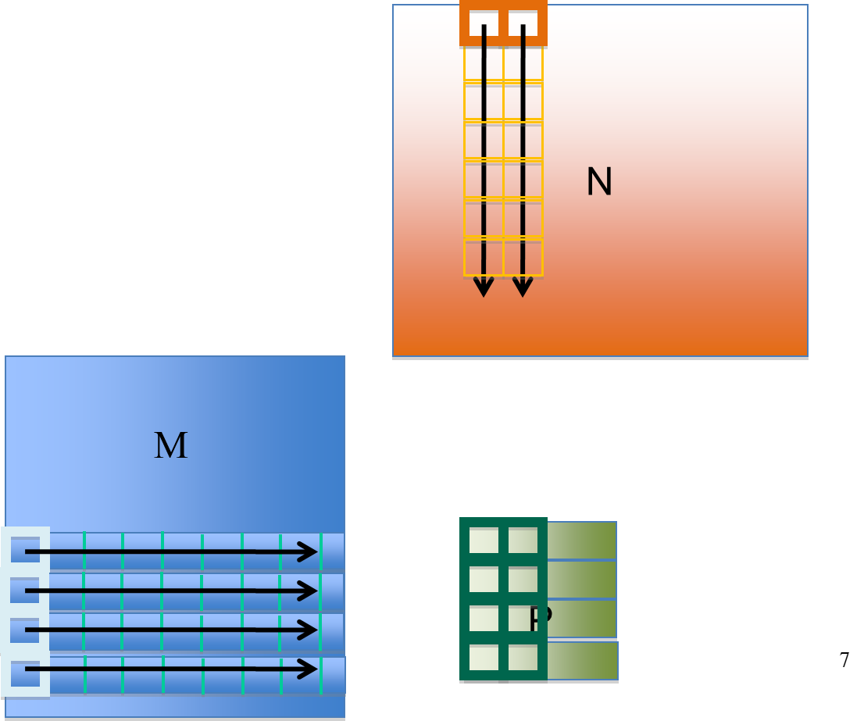
Joint Register and Shared Memory Tiling
Store input M tile and output P tile elements in registers
Store input N tile elements in shared memory
Decouple of M and N input tile widths
TILE_WIDTH_M , TILE_WIDTH_N
Key quantities
Number of threads = TILE_WIDTH_M
Output tile size = TILE_WIDTH_M * TILE_WIDTH_N
Reuses for each N element = TILE_WIDTH_M
Reuses for each M element = TILE_WIDTH_N
Each thread calculates TILE_WIDTH_N P elements
Example:
TILE_WIDTH_M = 4
TILE_WIDTH_N = 2
Slide credit: Hwu & Kirk
Notes:
We have two input matrices, M and N, and we use them to compute an output matrix, P. To perform a matrix multiplication using register and shared memory tiling, we store elements of the input matrix M and the output matrix P into registers, while elements of the matrix N are stored in the shared memory. We decouple the M and N input tile widths, which are related to key quantities such as the number of threads and the output tile size, and we reuse each element of N as many times as the size of the M tile and each element of M as many times as the size of the tile of M. Each thread calculates tile with M elements of P and uses registers to keep track of the necessary values from M and shared memory to access the elements from N. This is an example of how to use registers and shared memory to do tiling.

Slide 63
Systolic Arrays

Slide 64
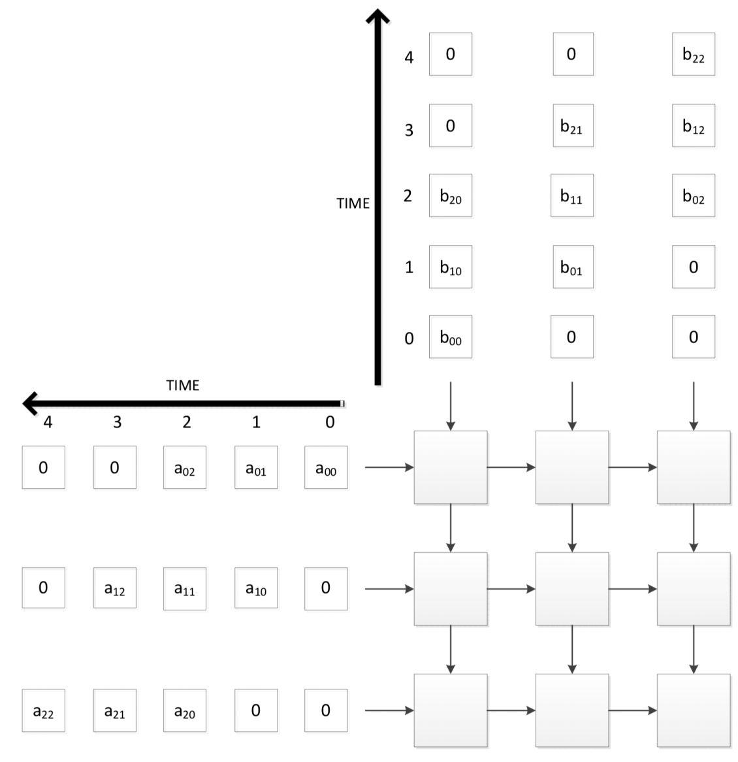
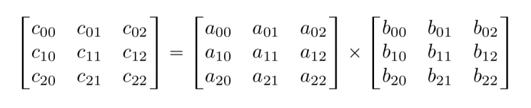
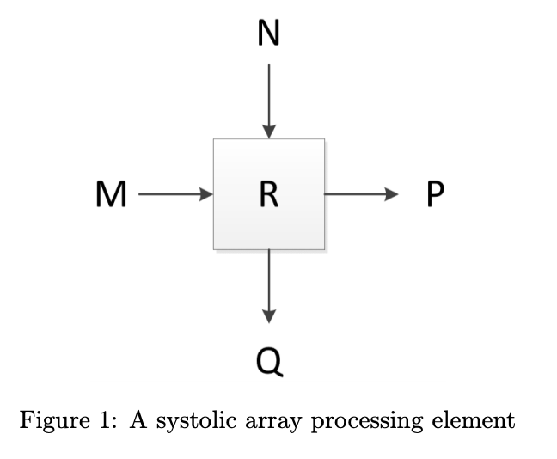
Example 2D Systolic Array Computation
Multiply two 3x3 matrices (inputs)
Keep the final result in PE accumulators
P = M
Q = N
R = R + M*N
Notes:
We want to perform matrix multiplication of two small matrices of size 3x3 and store the final result in the processing elements' accumulators of the systolic array. Each processing element has an internal register, an accumulator, to store partial results, two inputs, m and n, and performs multiplication and accumulation operations internally. The systolic array propagates the inputs to the outputs and performs the multiplication and accumulation operation internally. For this toy example, a systolic array of 3x3 elements is used. In each cycle, a new value from matrix a and matrix b is input, and the multiplication and accumulation operation is performed. After three cycles, the processing element will store the corresponding element of the output matrix c in its internal register.

Slide 65
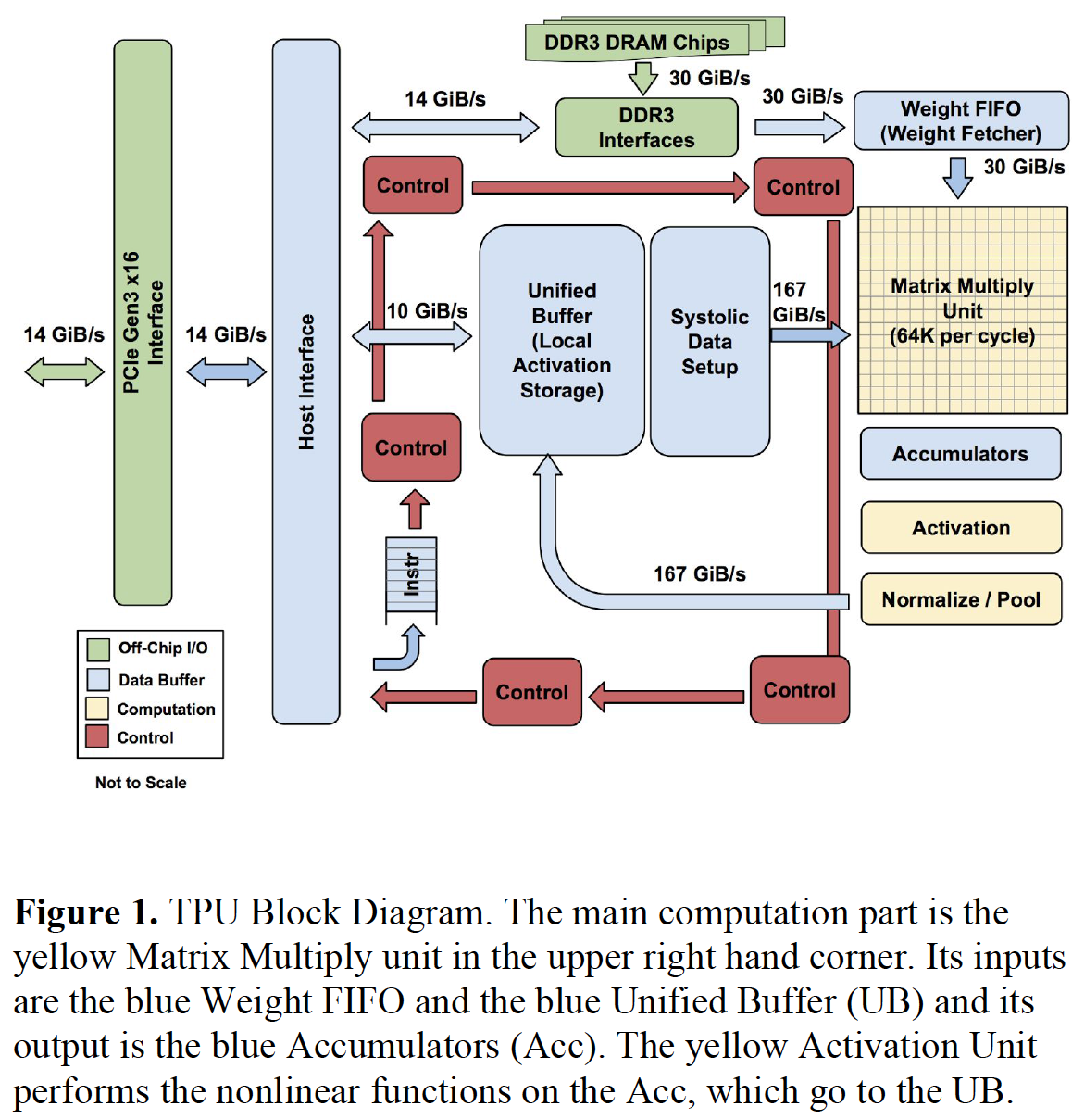
An Example Modern Systolic Array: TPU
Notes:
The Google TPU includes a matrix multiply unit that serves as the systolic array. The systolic array receives weights for convolutional layers and inputs from the unified buffer and performs accumulations and activation functions.

Slide 66
Prefix Sum (Scan)

Slide 67
Prefix Sum (Scan)
Prefix sum or scan is an operation that takes an input array and an associative operator,
E.g., addition, multiplication, maximum, minimum
And returns an output array that is the result of recursively applying the associative operator on the elements of the input array
Input array [x₀, x₁, …, x_{n-1}]
Associative operator ⊕
An output array [y₀, y₁, …, y_{n-1}] where
Exclusive scan: y_{i} = x₀ ⊕ x₁ ⊕ ... ⊕ x_{i-1}
Inclusive scan: y_{i} = x₀ ⊕ x₁ ⊕ ... ⊕ x_{i}
Notes:
The prefix sum, also known as a scan operation, is an operation that involves an input array and an associative operator, similar to reduction. The associative operator can be addition, multiplication, maximum or minimum. The output array is obtained by recursively applying the associative operator to the input array elements. The output can be an inclusive or exclusive scan, which determines if the operator includes the element corresponding to the specific index in the computation. The inclusive scan includes the corresponding element while the exclusive scan does not. In an inclusive scan, the operator is applied to all elements up to the current index, while in an exclusive scan, the operator is applied to all elements up to the previous index.

Slide 68
Scan Applications
Scan is a key parallel primitive that can
convert recurrences from sequential
into parallel
Scan is a basic building block of many parallel algorithms
E.g., stream compaction, partition, select, unique, radix sort, quicksort, string comparison, lexical analysis, polynomial evaluation, solving recurrences, tree operations, histograms, etc.
for(int i=1; i<n; i++)
out[i] = out[i-1] + f(i);
forall(i) {temp = f(i)};
scan(out, temp);
Notes:
Scan is a key parallel primitive used in GPU computing that can convert recurrences from sequential loops, where every iteration depends on the previous iteration, into parallel. After performing the conversion, a forall loop can get the elements of the input, store them in temporary variables, and then perform the scan operation, which is essential for many important parallel algorithms.

Slide 69
Examples of Exclusive and Inclusive Scan
Input
1
2
3
4
1
1
1
1
0
1
2
3
2
2
2
2
Output (Exclusive Scan)
out[0] = 0; // Identity value
for(int i=1; i<n; i++)
out[i] = out[i-1] + in[i-1];
0
1
3
6
10
11
12
13
14
14
15
17
20
22
24
26
Output (Inclusive Scan)
out[0] = in[0];
for(int i=1; i<n; i++)
out[i] = out[i-1] + in[i];
1
3
6
10
11
12
13
14
14
15
17
20
22
24
26
28
Notes:
An example of exclusive and inclusive scan using a toy representation of the input and output arrays. In an exclusive scan, we initialize the first element of the output array, out[0], to the identity value, and compute each subsequent element by adding the previous element of the output array and the previous element of the input array. Conversely, in an inclusive scan, we initialize the first element of the output array to the corresponding element of the input array and then perform the recursive addition, using the own element as one of the input operand

Slide 70
Hierarchical (Inclusive) Scan
Input
Block 0
Block 1
Block 2
Block 3
1
2
3
4
1
1
1
1
0
1
2
3
2
2
2
2
Per-block (Inclusive) Scan
1
3
6
10
1
2
3
4
0
1
3
6
2
4
6
8
Output (Inclusive Scan)
1
3
6
10
11
12
13
14
14
14
15
17
20
20
22
24
26
28
Notes:
A prefix sum or scan is an associative operation, similar to reduction, that returns an output array by recursively applying the associative operator on the elements of the input array. The input array and an associative operator are given, and the operator can be a multiplication, addition, maximum, or minimum. Exclusive and inclusive scans are shown using a toy representation of input and output arrays. A hierarchical scan operation is used in GPU computing, where we divide the input array into chunks assigned to different thread blocks, and perform per-block inclusive scan operations. We then use partial reduction results obtained from the per-block inclusive scan to create a new smaller array and apply a scan operation on the partial sums. This hierarchical approach involves launching GPU kernels, performing partial scan operations, and global synchronization. The partial sums can be scanned either on the CPU or a new kernel on the GPU, and then added to each of the output array chunks.

Slide 71
Hierarchical (Inclusive) Scan
Input
Block 0
Block 1
Block 2
Block 3
1
2
3
4
1
1
1
1
0
1
2
3
2
2
2
2
Per-block (Inclusive) Scan
1
3
6
10
10
1
2
3
4
4
0
1
3
6
6
2
4
6
8
8
10
4
6
8
Scan Partial Sums
10
14
20
28
Add
1
3
6
10
1
2
3
4
0
1
3
6
2
4
6
8
Output (Inclusive Scan)
+10
+14
+20
1
3
6
10
11
11
12
12
13
13
14
14
14
14
15
15
17
17
20
20
22
22
24
24
26
26
28
28

Slide 72
Hierarchical (Inclusive) Scan
Input
Block 0
Block 1
Block 2
Block 3
1
2
3
4
1
1
1
1
0
1
2
3
2
2
2
2
Per-block (Inclusive) Scan
1
3
6
10
10
1
2
3
4
4
0
1
3
6
6
2
4
6
8
8
10
4
6
8
Inter-block synchronization
Kernel termination and
Scan on CPU, or
Launch new scan kernel on GPU
Atomic operations in global memory
Scan Partial Sums
10
14
20
28
Add
1
3
6
10
1
2
3
4
0
1
3
6
2
4
6
8
Output (Inclusive Scan)
+10
+14
+20
1
3
6
10
11
11
12
12
13
13
14
14
14
14
15
15
17
17
20
20
22
22
24
24
26
26
28
28

Slide 73
Sparse Matrices and Sparse Matrix Computation

Slide 74
Sparse Matrices
A sparse matrix is one where many elements are zero
(many real world systems are sparse)
A dense matrix is one where the majority of elements are not zero
Opportunities:
Do not need to allocate space for zeros (save memory capacity)
Do not need to load zeros (save memory bandwidth)
Do not need to compute with zeros (save computation time)
Notes:
A dense matrix is one where the majority of elements are non-zero, while a sparse matrix is one where the majority of elements are zero. Since most matrices in the real world are sparse, this presents opportunities for saving memory capacity, memory bandwidth, and computation time. By not needing to allocate space for, load, or access zeros, we can make more efficient use of our resources.

Slide 75
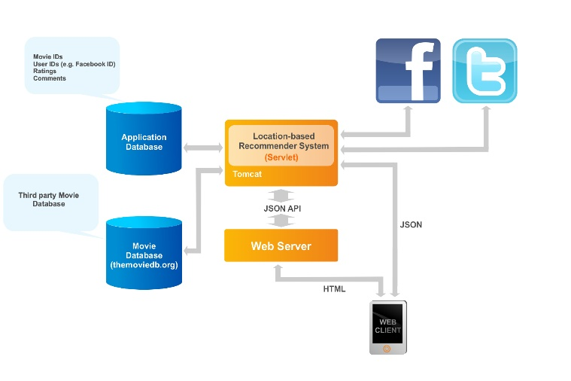
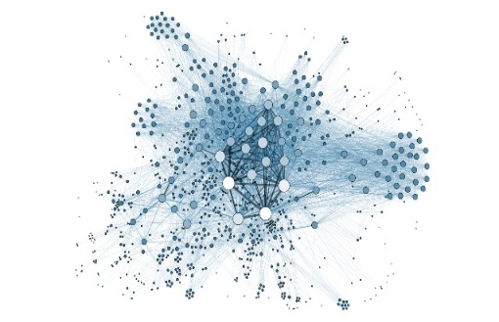

Sparse Matrices are Widespread Today
Recommender Systems
Graph Analytics
Neural Networks
PageRank
Breadth First Search
Betweenness
Centrality
Sparse DNNs
Graph Neural Networks
Collaborative Filtering
Notes:
The use of sparse matrices is widespread and they can be found in various applications such as recommender systems, graph analytics, and neural networks. Real world matrices tend to be highly sparse, providing opportunities to save memory and computation time.
Sparse Matrix Operations are widespread today.
They are critical components of domains like Recommender Systems, Graph Analytics AS WELL AS Neural Networks

Slide 76


Real-World Matrices Have High Sparsity
0.0003%
non-zero elements
2.31%
non-zero elements
Sparse matrix compression
is essential to enable
efficient storage and computation
Notes:
The fact that real-world matrices are highly sparse in various applications like recommender systems, graph analytics, and neural networks necessitates the use of efficient sparse matrix compression formats for storage and computation.
The matrices used in these workloads are extremele sparse.
For example, Facebook’s and Youtube’s social connectivity graphs have an extremely small amount of non-zero elements.
We conclude, Sparse matrix compression is an essential tool to enable efficient storage and computation

Slide 77
Sparse Matrix Storage Formats
Many storage formats for sparse matrices:
Coordinate Format (COO)
Compressed Sparse Row (CSR)
ELLPACK Format (ELL)
Jagged Diagonal Storage (JDS)
…
Format design considerations:
Space efficiency (memory consumed)
Flexibility (ease of adding/reordering elements)
Accessibility (ease of finding desired data)
Memory access pattern (enabling coalescing)
Load balance (minimizing control divergence)
Notes:
Regarding sparse matrix storage formats, there are many different ones, but some of the most popular ones are the coordinate format (COO), compressed sparse row (CSR), Lp format (ELL), and jack diagonal storage (JDS). Other formats will also be discussed later on. When choosing the right storage format, it's important to consider spatial efficiency, flexibility, accessibility, memory access pattern, load balancing, and minimizing control divergence. These considerations are crucial for optimizing the space, indexing, and operations for sparse matrices.

Slide 78
SpMV
Choice of best format depends on computation and matrix characteristics (e.g., sparsity)
We will use Sparse Matrix-Vector multiplication (SpMV) as an example to study different formats
×
=
Notes:
Sparse matrix formats are used to efficiently store and compute with sparse matrices, with some of the most popular formats including CSR, ELL, JDS, and coordinate formats. The choice of the best format depends on various factors such as computation, algorithm, and matrix characteristics such as sparsity. One key primitive used to demonstrate the use of these formats is sparse matrix-vector multiplication (SpMV), which involves computing the dot product of each row of the sparse matrix and the vector itself. By using SpMV, we can compare the performance and efficiency of different storage formats on the GPU.

Slide 79
Coordinate Format (COO)
Matrix:
1 | 7
5 |  | 3 | 9
 | 2 | 8
 |  |  | 6
Store every nonzero along with its row index and column index
Row:
0 | 0 | 1 | 1 | 1 | 2 | 2 | 3
Column:
0 | 1 | 0 | 2 | 3 | 1 | 2 | 3
Value:
1 | 7 | 5 | 3 | 9 | 2 | 8 | 6
Notes:
To implement sparse matrix vector multiplication (SPMV) using the COO format, we iterate over each non-zero element in the matrix and perform a dot product between its corresponding row and the input vector. The output is a new vector containing the results of all the dot products. This operation can be parallelized by assigning each thread to compute the dot product of one non-zero element with its corresponding row. The COO format is not very efficient in terms of memory usage, and the indexing can be quite slow.

Slide 80
SpMV/COO
Multiple threads writing to the same output
(need atomic operations)
Matrix:
1 | 7
5 |  | 3 | 9
 | 2 | 8
 |  |  | 6
×
=
Row:
0 | 0 | 1 | 1 | 1 | 2 | 2 | 3
Column:
0 | 1 | 0 | 2 | 3 | 1 | 2 | 3
Parallelization approach:
Assign one thread
per nonzero
Value:
1 | 7 | 5 | 3 | 9 | 2 | 8 | 6
Notes:
In the coordinate format, each non-zero element of the matrix is stored along with its row and column index. To implement spmb using this format, one thread is assigned per non-zero element, which ensures coalesced memory accesses. However, multiple threads may write to the same output element, necessitating the use of atomic operations, which can cause serialization of the execution.

Slide 81
COO Tradeoffs
Advantages:
Flexibility: easy to add new elements to the matrix, nonzeros can be stored in any order
Accessibility: given nonzero, easy to find row and column
SpMV/COO has coalesced memory accesses
SpMV/COO has no control divergence
Disadvantages:
Accessibility: given a row or a column, hard to find all nonzeros (need to search)
SpMV/COO uses atomic operations
Notes:
The advantages of COO include its flexibility in adding new elements and storing non-zeros in any order, easy accessibility to find rows and columns, and guaranteed coalesced memory accesses with no control divergence. However, it has the disadvantage that finding all non-zero elements for a given row or column can be difficult as it requires scanning the whole compressed adjacency matrix. COO also requires atomic operations, which can result in serialization.

Slide 82
Widely Used Format: Compressed Sparse Row
Compressed Sparse Row (CSR) provides high compression ratio
Used in multiple libraries & frameworks:
Intel MKL¹
TACO²
Ligra³
Polymer⁴
Gunrock⁵
Etc.
¹ Intel Math Kernel Library, http://software.intel.com/en-us/articles/intel-mkl/
² F. Kjolstad, S. Chou, D. Lugato, S. Kamil, and S. Amarasinghe, “taco: A Tool to Generate Tensor Algebra Kernels,” ASE 2017
³ J. Shun and G. E. Blelloch, “Ligra: A Lightweight Graph Processing Framework for Shared Memory,” PPoPP 2013
⁴ K. Zhang, R. Chen, and H. Chen, "Numa-aware Graph-structured Analytics," PPoPP 2015
⁵ Y. Wang, A. Davidson, Y. Pan, Y. Wu, A. Riffel, and J. D. Owens, "Gunrock: A High-performance Graph Processing Library on the GPU," PPoPP 2016
Notes:
The most widely used compression format is called Compressed Sparse Row. It is used in multiple frameworks and libraries.
CSR Stores only the non-zero elements of the sparse matrix and
that is the reason why it provides high compression ratios.
The CSR format is widely used, provides high compression ratio, and is the most popular format for sparse matrices. It is used in multiple state-of-the-art libraries and frameworks like Intel MKL library, TACO, Ligra, Polymer, and Gunrock for GPUs. The CSR format uses atomic operations for computation, and its advantages include better space utilization and better memory access pattern, while its disadvantages include difficulty in inserting new elements and possible control divergence.

Slide 83
Compressed Sparse Row (CSR)
Matrix:
1 | 7
5 |  | 3 | 9
 | 2 | 8
 |  |  | 6
Store nonzeros of the same row adjacently and an index to the first element of each row
RowPtrs:
0 | 2 | 5 | 7 | 8
Column:
0 | 1 | 0 | 2 | 3 | 1 | 2 | 3
Value:
1 | 7 | 5 | 3 | 9 | 2 | 8 | 6
Slide credit: Izzat El Hajj
Notes:
In the Compressed Sparse Row (CSR) format, non-zero values of each row are stored adjacent to each other, along with an index to the first element of each row. For each non-zero value, the column index is stored and there is one single pointer per row. For example, the first two elements with values one and seven start at pointer zero, but the next elements corresponding to row one start at index two of the arrays of columns and values.

Slide 84
SpMV/CSR
Matrix:
1 | 7
5 |  | 3 | 9
 | 2 | 8
 |  |  | 6
Parallelization approach:
Assign one thread to loop over each input row sequentially and update corresponding output element
×
=
RowPtrs:
0 | 2 | 5 | 7 | 8
Column:
0 | 1 | 0 | 2 | 3 | 1 | 2 | 3
Value:
1 | 7 | 5 | 3 | 9 | 2 | 8 | 6
Slide credit: Izzat El Hajj
Notes:
In the CSR format, one thread is assigned to loop over each input row sequentially and update the corresponding output element. The rows are assigned to different threads that participate in the computation. In the first iteration, every thread accesses the first element of the row, checking the row pointers array and then iterating element by element of the row to perform multiplication and accumulation.

Slide 85
SpMV/CSR
Matrix:
1 | 7
5 |  | 3 | 9
 | 2 | 8
 |  |  | 6
Parallelization approach:
Assign one thread to loop over each input row sequentially and update corresponding output element
×
=
RowPtrs:
0 | 2 | 5 | 7 | 8
Column:
0 | 1 | 0 | 2 | 3 | 1 | 2 | 3
Value:
1 | 7 | 5 | 3 | 9 | 2 | 8 | 6
Slide credit: Izzat El Hajj

Slide 86
SpMV/CSR
Matrix:
1 | 7
5 |  | 3 | 9
 | 2 | 8
 |  |  | 6
Parallelization approach:
Assign one thread to loop over each input row sequentially and update corresponding output element
×
=
RowPtrs:
0 | 2 | 5 | 7 | 8
Column:
0 | 1 | 0 | 2 | 3 | 1 | 2 | 3
Value:
1 | 7 | 5 | 3 | 9 | 2 | 8 | 6
Slide credit: Izzat El Hajj

Slide 87
CSR Tradeoffs (versus COO)
Advantages:
Space efficiency: row pointers smaller than row indexes
Accessibility: given a row, easy to find all nonzeros
SpMV/CSR avoids atomics, every thread owns its output
Disadvantages:
Flexibility: hard to add new elements to the matrix
Accessibility: given nonzero, hard to find row; given a column, hard to find all nonzeros
SpMV/CSR memory accesses are not coalesced
SpMV/CSR has control divergence
Slide credit: Izzat El Hajj
Notes:
CSR has advantages in terms of space efficiency due to the smaller size of row pointers, easy accessibility of all non-zero elements given a row, and the ability to avoid atomic operations. However, CSR has disadvantages in terms of flexibility when it comes to adding new elements, difficulty in finding a row given a column or all non-zeros, and the fact that memory accesses are not codeless, with threads accessing values at different distances from neighboring threads leading to control divergence and load imbalance. Another important and useful compressed format is the ELL format.

Slide 88
Compressed Sparse Column (CSC)
Matrix:
1 | 7
5 |  | 3 | 9
 | 2 | 8
 |  |  | 6
Like CSR, but groups nonzeros by column
(useful for computations other than SpMV that require column traversal)
ColPtrs:
0 | 2 | 4 | 6 | 8
Row:
0 | 1 | 0 | 2 | 1 | 2 | 1 | 3
Value:
1 | 5 | 7 | 2 | 3 | 8 | 9 | 6
Slide credit: Izzat El Hajj
Notes:
The compressed sparse column (CSC) matrix format is similar to CSR, but the non-zeros are grouped by column instead of row. Instead of having an array of pointers to the beginning of the rows, we have an array of pointers to the beginning of each column. Non-zero elements of the first column, such as one and five, are stored first, followed by the corresponding row values. The corresponding row and values are accessed using the column pointers.

Slide 89
Sparse Matrix Vector Multiplication
Sparse Matrix Vector Multiplication (SpMV):
Widely-used kernel in graph processing, machine learning, scientific computing …
A highly memory-bound kernel
Roofline Model
Peak Compute Performance
Performance
Peak Memory Bandwidth
SpMV
Operational Intensity

Slide 90
Can We Design a Better Compression Format?

Slide 91
Indexing Overhead in Sparse Kernels
Sparse Matrix Vector Multiplication (SpMV)
Indexing for every non-zero element of the sparse matrix to multiply with the corresponding element of the vector
Sparse Matrix Matrix Multiplication (SpMM)
Index matching for every inner product between the 2 sparse matrices
Indexing is expensive
for major sparse matrix kernels
Notes:
Let me show you the importance of indexing in two major sparse matrix kernels.
First, SpMV needs to perform Indexing for every non-zero element of the sparse matrix to multiply
with the corresponding element of the vector.
Second, SpMM requires index matching for every inner product between the 2 sparse matrices.
Index matching is the process of matching the indices of the row and column of the 2 matrices that need to be multiplied.
As we see, Indexing can be expensive for major sparse matrix kernels

Slide 92
Performing Indexing with Zero Cost
Reducing the cost of indexing
can accelerate sparse matrix operations
Notes:
To better understand the indexing bottleneck we conducted experiments where we perform indexing with zero Cost
The processor does not execute instructions or memory accesses related to indexing.
In this figure we demonstrate the performance achieved by the ZERO-COST INDEXING scheme compared against the default CSR implementation.
We evaluated 3 workloads, Sparse Matrix Sparse Matrix Addition, SpMV and SpMM. The results are average across a set of 15 matrices.
As we observe, for all the workloads the IDEAL CSR scheme results in performance improvements, especially in SpMM where the indexing is really intensive.
It turns out, that reducing the cost of indexing can accelerate sparse matrix operations

Slide 93
Limitations of Existing Compression Formats
1
Expensive discovery of the positions
of non-zero elements
General formats optimize for storage
2
Specialized formats assume
specific matrix structures
and patterns (e.g., diagonals)
Narrow
applicability
Notes:
Coming back to the compression formats,
, some specialized formats assume specific matrix structures and patterns like Diagonals. These formats are not general enough and offer narrow applicability.

Slide 94
What is an Ideal Compression Format?
A sparse matrix compression mechanism that:
Minimizes the indexing overheads
Can be used across a wide range of sparse matrices and sparse matrix operations
Enables high compression ratio
SMASH* proposes a bitmap-based compression format
* Kanellopoulos et al., "SMASH: Co-designing Software Compression and Hardware-Accelerated Indexing for Efficient Sparse Matrix Operations," MICRO 2019
Notes:
A sparse matrix compression mechanism that minimizes indexing overheads, as discussed, can be used across a wide range of sparse matrices and operations while enabling high compression ratios. To achieve this, the smash compression format was proposed, which is a bitmap-based compression format. The key idea of smash is to provide a hardware/software operating mechanism that enables highly efficient sparse vertical compression and computation.

Slide 95
SMASH: Key Idea
Hardware/Software cooperative mechanism:
Enables highly-efficient sparse matrix compression and computation
General across a diverse set of sparse matrices and sparse matrix operations
Software
Hardware
Efficient compression using a Hierarchy of Bitmaps
Unit that scans bitmaps to accelerate indexing
SMASH ISA
Notes:
To address the limitations of existing compression mechanisms we propose SMASH.
SMASH is a hardware/software cooperative mechanism that enables:
1)
And is
2)
On the software side, SMASH, efficiently compresses sparse matrices using a hierarchy of bitmaps.
On the hardware side, it employs hardware unit that scans the bitmap hierarchy and quickly determine the positions of non-zero elements.
Software manipulates the functionality of the hardware unit using a set of primitives called the SMASH ISA.

Slide 96
SMASH: Software Compression Scheme (I)
Software
Efficient compression using a Hierarchy of Bitmaps
Encodes the positions of non-zero elements
using bits to maintain low storage overhead
Notes:
The Software Compression Scheme Introduced in SMASH
Encodes the positions of non-zero elements using bits to maintain low storage overheads.

Slide 97
SMASH: Software Compression Scheme (II)
BITMAP:
Encodes if a block of the matrix contains
any non-zero element
MATRIX
BITMAP
ZEROS
ZEROS
1
0
0
0
Might contain high number of zero bits
NZ
ZEROS
1
0
0
0
0
1
0
0
ZEROS
NZ
ZEROS
ZEROS
0
1
0
0
0
0
0
0
0
0
0
0
ZEROS
ZEROS
ZEROS
ZEROS
0
0
1
1
0
0
1
1
ZEROS
ZEROS
NZ
NZ
Idea: Apply the same encoding recursively
to compress more effectively
Notes:
The core data structure behind our compression scheme is a bitmap.
The bitmap data structure is used to encode the presence/absence of non-zero elements in regions of the original sparse matrix.
I am going to show you an example of a bitmap compressing a sparse matrix.
On the left we divide the sparse matrix into blocks.
Blocks map one-to-one with bits of the bitmaps.
The first block of the matrix is a non-zero block. This means that it contains at least one non-zero element.
The first bit of the bitmap is set to 1 in this case.
The next few blocks of the matrix are zero-blocks. This means, that they contain only zero elements.
As we observe, depending on the block size, the bitmap hierarchy might contain a high number of zero bits.
One simple idea, is to apply the same encoding recursively to compress more effectively.

Slide 98
Hierarchy of Bitmaps
Compression Ratio 2:1
Z
Zero Region
MATRIX
NZ
Non-Zero Region
1
1
Bitmap 2
NZ
Z
Z
Z
Z
Z
Z
Z
Compression Ratio 4:1
Z
Z
Z
Z
1
0
0
1
Bitmap 1
Z
Z
NZ
NZ
1
0
0
0
0
0
0
0
0
0
0
0
0
0
1
1
Bitmap 0
NZ
NZ
NZ
NON-ZERO VALUES ARRAY
Storage
Efficient
Fast
Indexing
Hardware
Friendly
Notes:
We demonstrate a simplified example of an hierarchy of bitmaps.
The original matrix contains 4 non-zero blocks.
We store these 4 blocks contiguously in memory using a data structure called NON-ZERO VALUES ARRAY.
Based on the positions of the non-zero blocks we create Bitmap-0.
Set bits represent non-zero blocks and encode their respective positions in the sparse matrix.
We recursively build the higher levels of the bitmap hierarchy. Bitmap-1 encodes a 4-bit block of Bitmap-0 and Bitmap-2 encodes a 2-bit block of Bitmap-1.
As we see the compression ratio across the levels of the bitmap hierarchy can be different. This provides an opportunity to compress matrices with different sparsity characteristics.
One advantage of the Hierarchy of Bitmaps is that it does not keep in memory the bitmap and matrix blocks that contain zero elements or bits.
As we see in this example, Bitmap 0 has 2 blocks that contain only zero bits. These blocks are not kept in memory .
Determining the positions of the non-zero elements of the matrix, requires traversing the bitmap hierarchy in a depth first search manner. You can find more details about the index calculation in the paper.
As I mentioned before, one advantage of the hierarchy of bitmaps, is that it does not store in memory the zero blocks of the sparse matrix and the bitmaps.
Due to that,
Storage efficient compression scheme that enables fast indexing (we don’t need to scanthe zero blocks)
Scanning the bitmaps requires bitwise operations which make the Hierarchy of Bitmaps amenable to hardware acceleration.

Slide 99
Using Tensor Core Units

Slide 100
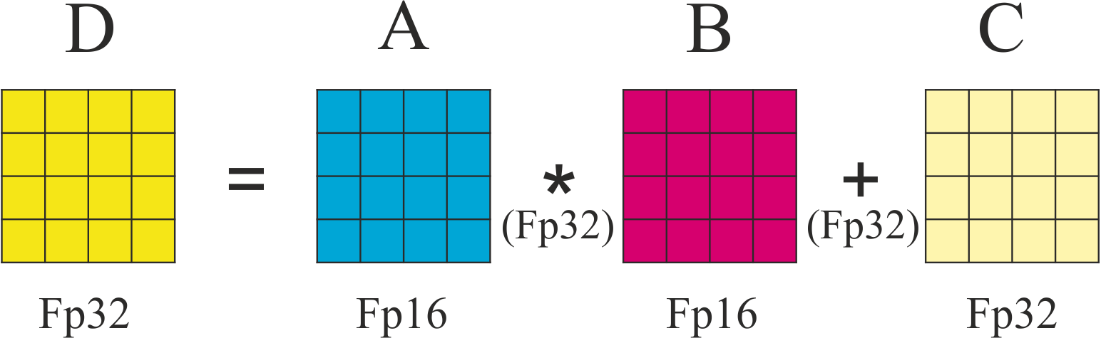
Characteristics of Tensor Core Units (TCUs)
Definitions
TCUs perform matrix multiplication between “small” matrices
“Small” is, e.g., 16x16
Mixed precision: Result/Accumulator can be in FP32
D = A × B + C
or
C = A × B + C
Slide credit: Orestis Zachariadis
Notes:
Tensor core units are specialized processing elements found in each GPU core of NVIDIA GPUs. They perform matrix multiplication on small matrices, typically of size 16 by 16, using mixed precision. The operands are represented in a 16-bit floating point, while the results and accumulators use a 32-bit floating point. This is essentially the computation that they perform: the multiplication of two submatrices or tiles of two matrices, A and B. We can also add a different matrix and perform a multiply-accumulate or multiply-add operation.

Slide 101
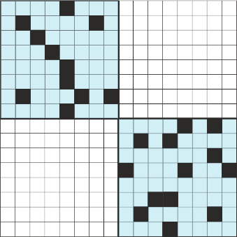
How to Load Sparse Bitmaps into TCUs?
16
We use 8x8 tiles
Each warp multiplies 2 8x8 tiles
Tensor cores are efficient even if not fully utilized¹
TCU layout
16
Nonzeros colored black
¹ Dakkak et al., “Accelerating Reduction and Scan Using Tensor Core Units,” ICS 2019
Slide credit: Orestis Zachariadis
Notes:
To make use of the TCUs without utilizing the complete ECU, we can map two types of 8x8 tiles onto the 16x16 tiles provided by the TCUs. However, we cannot use all the functional units or processing elements as it may lead to incorrect results. Despite this, we can still achieve a good performance improvement by utilizing the TCUs.

Slide 102
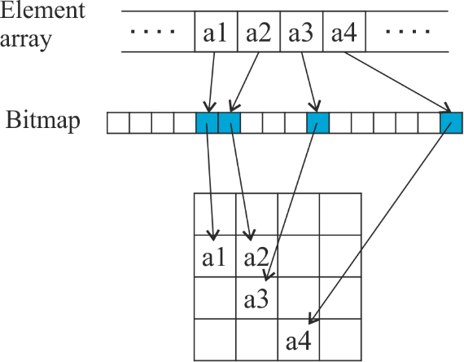
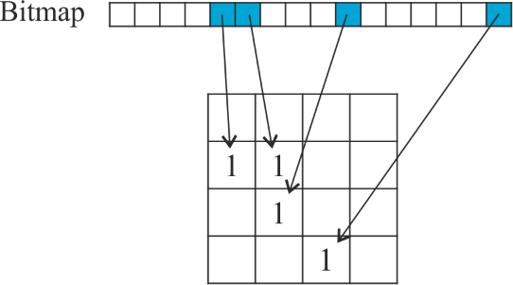
Allocating Memory for the Output
Memory pre-allocation
Before executing the matrix multiplication we need to allocate memory
We know how much memory to allocate only after the multiplication
Various solutions: Upper bound, probabilistic, precise, progressive
Elements
How many elements?
Counting kernel
Multiplication kernel
Precise method
We estimate the count of elements in the output with a partial multiplication
We do not load any actual values, instead we use only the bitmaps
Similar code base, TCUs, etc.
Slide credit: Orestis Zachariadis
Notes:
Another important consideration in sparse matrix computation is how to allocate memory for the output, as we may not know how many non-zero elements we will have. Different solutions have been proposed, such as allocating an upper bound or using probabilistic estimation. A precise method is used, where a counting kernel is applied to determine the number of non-zero elements in the output matrix based on the bitmaps. This allows for accurate memory allocation.

Slide 103
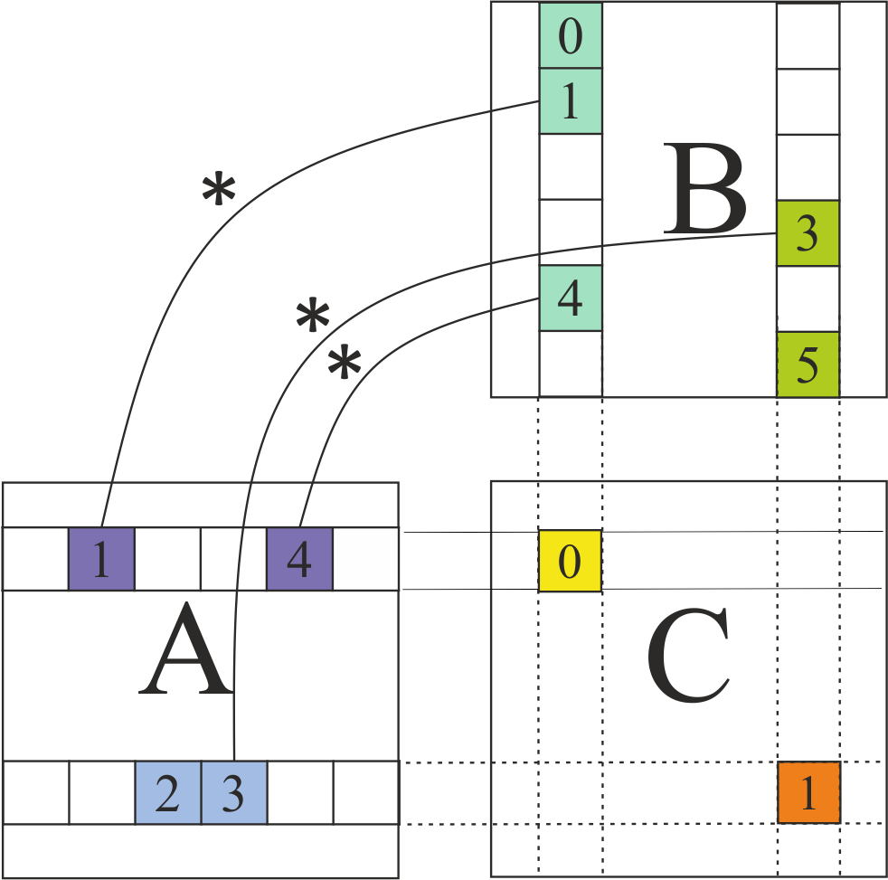
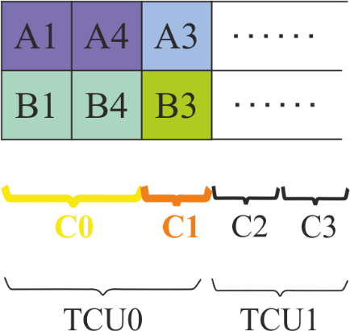
Finding Tiles to Multiply
Finding which tiles to multiply
Task list
We perform the matrix multiplication as several tile multiplications of the form C = A*B + C
Sorting
We find which tiles of A need to be multiplied with which tiles of B for each tile of C
We create a task list of tiles to multiply
Finding matrix multiplications
We group intermediate products using segmented sort algorithms
Accumulation of varied number of intermediate products for each output tile.
Slide credit: Orestis Zachariadis
Notes:
Mention of inner product w.r.t. intermediate products. An inner product where multiplication is matrix multiplication and addition is element-wise addition.
We use the counting kernel to find the tiles for multiplication and create a task list based on these tiles, scheduling the multiplication of sub-matrices on the Tensor Core Units. The task list is generated by finding the tiles in matrix A that need to be multiplied with the tiles in matrix B to obtain the tiles of matrix C. Intermediate products are grouped using a segmented sort algorithm. This task list allows us to feed the Tensor Core Units efficiently for matrix multiplication.

Slide 104
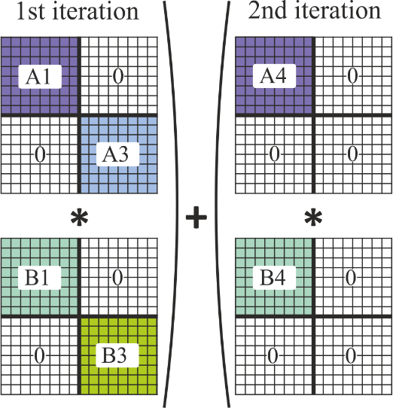
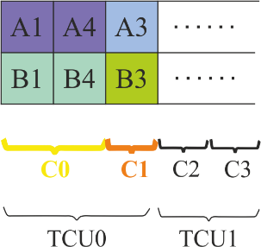
Multiplying with TCUs (I)
2nd iteration
Multiplying tiles
The task list feeds the TCUs
We calculate 2 tiles of the output with each TCU
We iterate until all intermediate products of both the inner products are accumulated
1st iteration
1st iteration
Slide credit: Orestis Zachariadis
Notes:
We use the list of tasks to feed the TensorFlow units, and in this example, we map a1 and b1 in the same part of the 16 by 16 tile to compute c0, while in the second iteration, we map a4 and b4 in the same part of the output tile to accumulate the result.

Slide 105


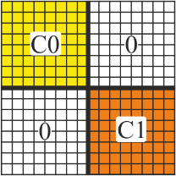
Multiplying with TCUs (II)
Warp-wide ballot
Bitmap C0 | b0110 | b0001 | b1100
Image: Getty images
Bitmap C1 | b0010 | b1001
Elements C0 | 10 | 15 | 20 | 40 | 50
Elements C1 | 5 | 13 | 7
Slide credit: Orestis Zachariadis
Notes:
In order to obtain the bitmap of the output matrix c, the researchers make use of the ballot function, where each thread checks whether the corresponding element is zero or not, and based on that, the bitmap is created.

Slide 106
Graph Search

Slide 107
Dynamic Data Extraction
The data to be processed in each phase of computation need to be dynamically determined and extracted from a bulk data structure
Harder when the bulk data structure is not organized for massively parallel access, such as graphs
Graph algorithms are popular examples that perform dynamic data extraction
Widely used in EDA, NLZP, and large scale optimization applications
We will use Breadth-First Search (BFS) as an example
Slide credit: Hwu & Kirk
Notes:
Dynamic data extraction is a challenge that arises when the data to be processed in each phase of computation is extracted from a complex and irregular data structure, such as in the case of graph algorithms. Breadth-first search (BFS) is a popular example of such an algorithm, widely used in design automation and other fields.

Slide 108
Main Challenges of Dynamic Data Extraction
Input data need to be organized for locality, coalescing, and contention avoidance as they are extracted during execution
The amount of work and level of parallelism often grow and shrink during execution
As more or less data is extracted during each phase
Hard to efficiently fit into one GPU kernel configuration, without dynamic parallelism support (Kepler and beyond)
Different kernel strategies fit different data sizes
Slide credit: Hwu & Kirk
Notes:
The irregularity of the data structure makes dynamic data extraction particularly challenging. The main challenge of dynamic data extraction is to organize the input data for locality coalescing and contention avoidance as it is extracted during execution. Additionally, the amount of work and level of parallelism can grow and shrink during execution, so the kernel must be created with different strategies to adapt to the amount of data and work required in each iteration. This is well-suited for dynamic parallelism and is available in CUDA since the Kepler architecture. Graph algorithms, such as breadth-first search (BFS), are popular examples that perform dynamic data structure and are used in many fields, including design automation.

Slide 109
Graph and Sparse Matrix are Closely Related
0
1
2
3
4
5
6
7
8
3
0
 | 1 | 1
 |  |  | 1 | 1
 |  |  |  |  | 1 | 1 | 1
 |  |  |  | 1 |  |  |  | 1
 |  |  |  |  | 1 |  |  | 1
 |  |  |  |  |  | 1
 |  |  |  |  |  |  |  | 1
1 |  |  |  |  |  | 1
1
1
4
8
2
3
0
5
4
2
5
6
6
7
7
8
Adjacency matrix
Slide credit: Hwu & Kirk
Notes:
Graphs and sparse matrices are closely related, and the adjacency matrix is a logical representation of a graph in memory. The adjacency matrix has non-zero elements only in positions that represent edges, and in the case of unidirectional edges, the matrix is not symmetrical. Sparse matrices are widely used in many fields, and they have many zero elements, leading to a challenge in their computation.

Slide 110
(Compressed) Edge Representation of a Graph
0
1
2
3
4
5
6
7
8
3
0
 | 1 | 1
 |  |  | 1 | 1
 |  |  |  |  | 1 | 1 | 1
 |  |  |  | 1 |  |  |  | 1
 |  |  |  |  | 1 |  |  | 1
 |  |  |  |  |  | 1
 |  |  |  |  |  |  |  | 1
1 |  |  |  |  |  | 1
1
1
4
8
2
3
0
5
2
4
5
6
6
7
7
8
row pointers source[10]
0
2
4
7
9
11
12
13
15
15
CSR format
column indices destination[15]
1
2
3
4
5
6
7
4
8
5
8
6
8
0
6
non-zero elements
data[15]
1
1
1
1
1
1
1
1
1
1
1
1
1
1
1
Slide credit: Hwu & Kirk
Notes:
To store the compressed representation of a graph, we need two arrays: the source array, which represents individual vertices, and the column indices array, which represents where the edges finish. Additionally, we need the data array that holds the non-zero elements or weights. BFS is an algorithm used for graph traversal that explores all the vertices at the same level before moving to the next level.

Slide 111
Breadth-First Search (BFS)
To determine the minimal number of hops that is required to go from a source node to a destination node (or all destinations)
2
3
1
2
1
4
3
8
0
1
5
0
2
2
6
Desirable Outcome
2
7
2
Slide credit: Hwu & Kirk
Notes:
In breadth-first search (BFS), the minimum number of hops needed to go from a source node to a destination node or all destinations is determined. If node 0 is selected as the source node, each vertex except vertex 0 is marked with the distance from the source vertex. BFS is performed in multiple iterations to achieve the desirable outcome.

Slide 112
Breadth-First Search: Example
Start with a source node
Identify and mark all nodes that can be reached from the source node with 1 hop, 2 hops, 3 hops, …
-1
3
-1
-1
1
4
-1
8
0
-1
5
Initial Condition
0
-1
2
6
-1
7
-1
Slide credit: Hwu & Kirk
Notes:
We will perform this search in multiple iterations, starting with the source node, and identify the destination vertices that can be reached with one, two, three, etc. hops. Initially, the distance to each of the destination vertices is set to minus one or infinity.

Slide 113
Breadth-First Search – Initial Condition
-1
3
-1
-1
1
4
-1
8
0
-1
5
0
-1
2
6
-1
7
-1
Slide credit: Hwu & Kirk
Notes:
In the breadth-first search algorithm, we perform the search in multiple iterations to determine the minimum number of hops required to go from a source node to a destination node or all destinations. Initially, we assign a distance of minus one or infinity to all destination vertices. In each iteration, we identify the reachable nodes from the previous frontier, starting from the source node, and update their distances.

Slide 114
Breadth-First Search – 1 Hop
First Frontier (level 1 nodes)
1, 2
-1
3
1
-1
1
4
-1
8
0
1
5
0
-1
2
6
-1
7
-1
Slide credit: Hwu & Kirk
Notes:
The first frontier includes the closest neighbors or the neighbors of the source node.

Slide 115
Breadth-First Search – 2 Hops
First Frontier (level 1 nodes)
1, 2
Second frontier (level 2 nodes)
3, 4, 5, 6, 7
2
3
1
2
1
4
-1
8
0
1
5
0
2
2
6
2
7
2
Slide credit: Hwu & Kirk
Notes:
In subsequent frontiers, we visit the neighbors of the nodes in the previous frontier until we reach the desired outcome.

Slide 116
Breadth-First Search – 3 Hops
First Frontier (level 1 nodes)
1, 2
Second frontier (level 2 nodes)
3, 4, 5, 6, 7
Third frontier (level 3 nodes)
8
…
2
3
1
2
1
4
3
8
0
1
5
0
2
2
6
2
7
2
Desirable Outcome
Slide credit: Hwu & Kirk

Slide 117
Breadth-First Search – Node 2 as Source
3
1
4
8
0
5
2
6
7
Slide credit: Hwu & Kirk

Slide 118
Breadth-First Search – Node 2 as Source
First Frontier (level 1 nodes)
5, 6, 7
Second frontier (level 2 nodes)
0, 8
Third frontier (level 3 nodes)
1
…
4
3
3
4
1
4
2
8
0
0
5
1
2
2
6
1
7
1
Slide credit: Hwu & Kirk
Notes:
The solution is different for different source nodes, and the desired outcome is to mark each vertex with its distance from the source node.

Slide 119
BFS: Processing the Frontier (2nd Iteration)
3
2
-1
2
3
0
label
0
-1
-1
1
1
1
1
1
2
dest
2
3
4
5
6
7
4
8
5
8
6
8
0
6
source
(edges)
0
0
2
2
4
7
9
11
12
13
15
15
15
15
p_frontier
0
8
Slide credit: Hwu & Kirk

Slide 120
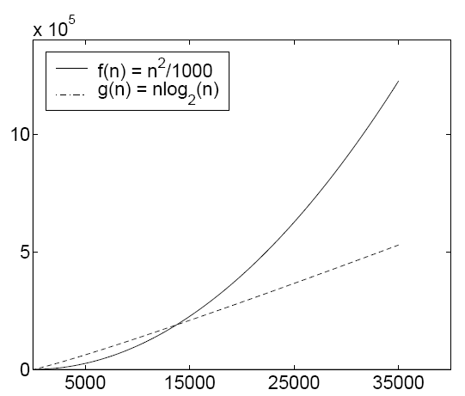
Potential Pitfall of Parallel Algorithms
Greatly accelerated n² algorithm is still slower than an nlog(n) algorithm for large data sets
Always need to keep an eye on fast sequential algorithm as the baseline
Running Time
Problem Size
Slide credit: Hwu & Kirk
Notes:
There are various ways to implement bfs on parallel architectures and GPUs, but it's crucial to be mindful of the algorithm's complexity. n-squared algorithms can become significantly slower than o-n or o-n log-n algorithms as the problem size increases. The black line in the plot represents an n-squared complexity function, while the dashed line represents an n log-n problem. Initially, the running time of the n-squared algorithm is smaller than the n log-n algorithm. However, as the problem size increases, the opposite occurs.

Slide 121
Node-Oriented Parallelization
Each thread is dedicated to one node
All nodes visited in all iterations
Every thread examines neighbor nodes to determine if its node will be a frontier node in the next phase
Complexity O(VL+E) (Compared with O(V+E))
L is the number of levels
Slower than the sequential version for large graphs
Especially for sparsely connect graphs
5
6
7
0
1
2
3
4
5
5
6
6
7
7
8
0
0
1
2
3
4
5
6
7
8
8
8
0
Harish et al., "Accelerating Large Graph Algorithms on the GPU using CUDA,” HiPC 2007
Slide credit: Hwu & Kirk
Notes:
There are different ways of implementing BFS on parallel architectures and GPUs. The first one is called node-oriented parallelization, where each thread is assigned to a node, and in each iteration, the thread examines if the neighbor nodes of the assigned node are in the frontier of the next phase. However, this approach has a complexity of O(vl+e), where v is the number of vertices, l is the maximum level, and e is the number of edges. Therefore, the performance of this approach may be slower than the sequential version, especially for sparsely connected graphs.

Slide 122
Matrix-Based Parallelization
Propagation is done through matrix-vector multiplication
For sparsely connected graphs, the connectivity matrix will be a sparse matrix
Complexity O(V+EL) (compared with O(V+E))
Slower than sequential for large graphs
s
s
s
s
u
u
u
u
v
v
v
v
s
u
v
Deng et al., "Taming Irregular EDA applications on GPUs,” ICCAD 2009
Slide credit: Hwu & Kirk
Notes:
Another possible implementation of BFS is matrix-based parallelization. In this approach, the next frontier is obtained by doing a matrix-vector multiplication where the connectivity matrix is a sparse matrix. The matrix is transposed to do the column times vector multiplication to obtain the output vector that represents the output frontier. The problem with this approach is that the complexity is also n-squared because it's v plus e times l, which is also not efficient for very large graphs. Despite this, matrix-based parallelization is being used in some contexts.

Slide 123
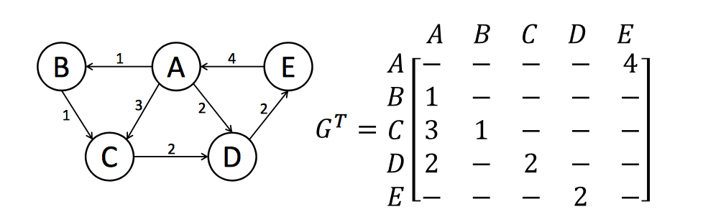
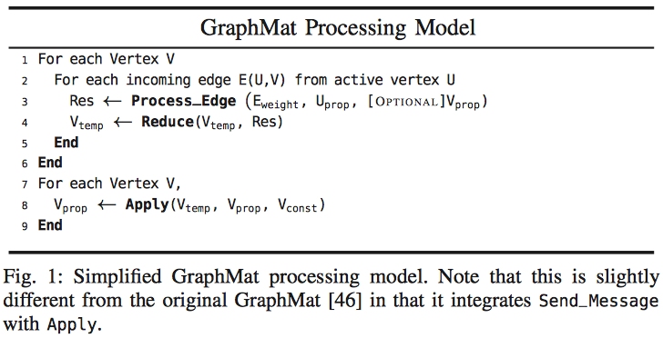
Linear Algebraic Formulation
Logical representation and adjacency matrix
Vertex programming model
(1)
(2)
(1) Sundaram et al., "GraphMat: High Performance Graph Analytics Made Productive," PVLDB 2015
(2) Ham et al., "Graphicionado: A High-Performance and Energy-Efficient Accelerator for Graph Analytics," MICRO 2016
Notes:
In the linear algebraic formulation, the vertex programming model is used to perform several steps, such as process edge reduction, apply boundary conditions, and apply the operator. An example of this formulation uses the logical representation of a graph's adjacency matrix, which may contain elements that differ from one depending on the corresponding edge's actual weight. This method's advantage is that it has lower complexity than the previous two methods, making it more efficient for large graphs.

Slide 124
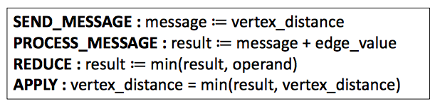
Mapping Vertex Programs to SpMV
Example: Single Source Shortest Path (SSSP)
Generalized SpMV:
Replace mul with add and add with min
Sundaram et al., "GraphMat: High Performance Graph Analytics Made Productive," PVLDB 2015
Notes:
We discuss the single source shortest path algorithm which is related to breadth-first search. This algorithm involves three steps - process message, send message, and apply, and it also includes another step called reduce. We use the adjacency matrix and perform the spmv operation using addition and minimum to obtain the output frontier. We then update the labels using the previous frontier and compare them to the new frontier to calculate the minimum distances from the source node to all other nodes in the graph.

Slide 125
Need a More General Technique
To efficiently handle most graph types
Use more specialized formulation when appropriate as an optimization
Efficient queue-based parallel algorithms
Hierarchical scalable queue implementation
Hierarchical kernel arrangements
Slide credit: Hwu & Kirk
Notes:
The efficient queue-based parallel algorithms we are going to discuss are based on two basic ideas. The first one is a hierarchical scalable q implementation, which allows us to efficiently handle most graph types. Additionally, these algorithms allow us to use specialized formulations as an optimization when appropriate.

Slide 126
An Initial Attempt
Manage the queue structure
Complexity: O(V+E)
Dequeue in parallel
Each frontier node is a thread
Enqueue in sequence using atomic operations
Poor coalescing
Poor scalability
No speedup
5
6
7
8
0
Parallel dequeue
5
6
7
8
0
0
8
Atomic operations
Slide credit: Hwu & Kirk
Notes:
A hierarchical scalable queue implementation and hierarchical kernel arrangement are two basic ideas of efficient cubase parallel algorithms that can handle most graph types. The initial attempt involves managing the key structure with a complexity of v plus e, but it has a significant drawback because two threads assigned to enqueue two elements at the same time may overwrite each other, requiring the use of atomic operations that have a problem with serialization, especially if there are many nodes in the input frontier, and many threads are working in parallel. This overhead should be avoided or at least alleviated.

Slide 127
Parallel Insert-Compact Queues
Parallel enqueue with compaction cost
Not suitable for light-node problems
v
t
x
v
t
x
Propagate
-
-
u
-
y
-
u
y
Compact
u
y
Lauterbach et al., “Fast BVH Construction on GPUs,” Computer Graphics Forum 2009
Slide credit: Hwu & Kirk
Notes:
One way to avoid using atomic operations is by utilizing parallel insert compact queues where nodes in the output frontier are first stored in a sparse manner with pre-assigned positions. Then, in a subsequent step, compaction is performed to filter out empty elements in the frontier. However, this method may not perform well in situations with light node problems, where only a few elements contain nodes of the output frontier.

Slide 128
(Output) Privatization
Avoid contention by aggregating updates locally
Requires storage resources to keep copies of data structures
Private
Results
Local
Results
Global
Results
Slide credit: Hwu & Kirk
Notes:
The idea is to use atomic privatization operations, but optimize their use by using hierarchical queues and local results that are later merged into global results. This technique is called privatization, and now we are using it in graph processing, specifically with the use of hierarchical queues.

Slide 129
Recall: Histogram Privatization
Privatization: Per-block sub-histograms in shared memory
Threads use atomic operations in shared memory
Block 0’s sub-histo
Block 1’s sub-histo
Block 2’s sub-histo
Block 3’s sub-histo
Shared memory
Parallel reduction
Global memory
Final histogram

Slide 130
Basic Ideas
Each thread processes one or more frontier nodes and inserts new frontier nodes into its private queues
Find a location in the global queue for each new frontier node
Build queue of next frontier hierarchically
q1
q2
q3
Local
a
b
c
g
h
i
j
Local queues
Index = offset of q2 (#node in q1) + index in q2
Global queue
Global
h
Slide credit: Hwu & Kirk
Notes:
The basic ideas of this approach involve each thread processing one or more frontier nodes and inserting new frontier nodes into its private queues and local queues. They then need to find the location in the global queue for their own output frontier nodes. The queues are built hierarchically, first creating the local queues, then merging them into the global queue, resulting in a two-level hierarchy.

Slide 131
Two-level Hierarchy
Block queue (b-queue)
Inserted by all threads in a block
Resides in Shared Memory
Global queue (g-queue)
Inserted only when a block completes
Problem:
Collision on b-queues
Threads in the same block can cause heavy contention
Shared Mem
b-queue
g-queue
Global Mem
Slide credit: Hwu & Kirk
Notes:
On the GPU, block queues or BQs are used where all active threads in a block insert their output frontier nodes, and these queues reside in fast global memory accessible by all threads in the block. A global queue is then created by updating the corresponding position with the block queue, but collisions can still occur in the block queue, requiring the use of atomic operations. However, the overhead of using atomic operations is reduced through privatization, which creates local results merged into global results, avoiding the creation of a single queue in global memory.

Slide 132
Hierarchical Queue Management
Advantage and limitation
The technique can be applied to any inherently sequential data structure
As long as the exact global ordering between queue contents is not required for correctness or optimality (more of a list)
The b-queues are limited by the capacity of shared memory
If we know the upper limit of the degree, we can adjust the number of threads per block accordingly
Overflow mechanism to ensure robustness
Slide credit: Hwu & Kirk
Notes:
The hierarchical queue management technique can be applied to any inter and sequential data structure as long as the exact global order between contents is not required. This technique has an advantage, as it reduces the overhead of using atomic operations. However, this kind of solution requires problems that can tolerate the absence of global ordering, and BQs are limited by the capacity of the shared memory. To overcome this limitation, we can adjust the number of threads per block according to the upper limit of the degree or have an overflow mechanism to avoid block queue overflow. When the number of elements in the block queue reaches its maximum, we can move these elements to the global queue and then clean the local queue to continue with the current iteration.

Slide 133
Kernel Arrangement
Creating global barriers needs frequent kernel launches
Too much overhead
Solutions:
Partially use GPU-synchronization
Multi-layer Kernel Arrangement
Dynamic Parallelism
Persistent threads with global barriers
2
Kernel call
5
6
7
Kernel call
8
0
Kernel call
Slide credit: Hwu & Kirk
Notes:
The hierarchical kernel arrangement involves dividing the input frontier among different thread blocks, with each block processing its assigned nodes and inserting output frontier nodes into a block queue. Once all blocks have finished their work, the global queue is updated by concatenating the block queues. In order to synchronize the blocks, global barriers need to be created, which can be achieved by kernel termination and relaunch, but this method may be too inefficient for this problem due to the low amount of computation involved. Alternative solutions include partially used GPU synchronization, a multi-layer kernel arrangement, and persistent threads with global barriers created using atomic operations.

Slide 134
Hierarchical Kernel Arrangement
Customize kernels based on the size of frontiers
Use fast barrier synchronization when the frontier is small
Kernel 1: Intra-block synchronization
Kernel 2: Kernel re-launch
One-level parallel propagation (i.e., iteration)
Slide credit: Hwu & Kirk
Notes:
To optimize the performance of graph processing on GPUs, we can customize the kernels based on the size of the frontiers. For small-sized frontiers, we can use intra-block synchronization, where a single thread block in the whole GPU can use its own local queue in the shared memory, and synchronization is done using sync threads. However, when the size of the output frontier becomes too large, we need to use more than one thread block and terminate the kernel for coarse-grained synchronization. Therefore, we design two different kernels: kernel one uses intra-block synchronization, while kernel two uses kernel termination and relaunch.

Slide 135
Kernel Arrangement (I)
Kernel 1: small-sized frontiers
Only launch one block
Use __syncthreads();
Propagate through multiple levels
Only b-queue
No g-queue during propagation
Save global memory access
Very fast
Slide credit: Hwu & Kirk
Notes:
To optimize processing for small size frontiers, we can launch a single thread block that iteratively visits the nodes in the input queue, creates the output queue in the block queue (bq), and synchronizes using sync threads before moving to the next iteration. Here, we use as many threads as needed to process the nodes in the bq and propagate through multiple levels. Since we don't need to access the global queue, this approach saves time and reduces global memory accesses.

Slide 136
Kernel Arrangement (II)
Kernel 2: big-sized frontiers
Use kernel re-launch to implement synchronization
The kernel launch overhead is acceptable considering the time to propagate a huge frontier
Or, one can use dynamic parallelism to launch new kernels from kernel 1 when the number of nodes in the frontier grows beyond a threshold
Dynamic parallelism can also help with load balancing
Slide credit: Hwu & Kirk
Notes:
When the frontier is bigger, the kernel tool is used. In this kernel, the kernel is terminated and relaunched for synchronization. The overhead of relaunching the kernel might be tolerable depending on the size of the frontier. At some point, the kernel launch overhead might become negligible. Alternatively, dynamic parallelism can be used to launch new kernels from the kernel with a single thread block. When the threshold exceeds one thread block, active threads launch new kernels to process the nodes in the output frontier.

Slide 137
Hierarchical Kernel Arrangement
Customize kernels based on the size of frontiers
Use fast barrier synchronization when the frontier is small
Kernel 1: Intra-block synchronization
Kernel 2: Kernel re-launch
One-level parallel propagation (i.e., iteration)
Slide credit: Hwu & Kirk

Slide 138
Dynamic Parallelism

Slide 139
Dynamic Parallelism
GPU programming frameworks provide an interface to express dynamic refinement algorithms in a more natural way
This dynamic parallelism interface allows GPU threads to launch GPU kernels when new work is dynamically discovered
Recall BFS
Each node in the frontier has a different number of neighbors
CUDA Dynamic Parallelism
Important semantics when a kernel is launched from a kernel
Performance considerations
Notes:
Dynamic parallelism in GPU programming frameworks like CUDA and OpenCL provides a more natural way to express dynamic refinement algorithms. This interface enables GPU threads to launch GPU kernels when new work is discovered dynamically. For example, in BFS graph search, each node in the frontier has a different number of neighbors, so the amount of work varies depending on the nodes in the frontier. In these cases, dynamic parallelism can be very useful. It enables us to perform device-agnostic implementations and to use dynamic parallelism to refine and adjust parallelism dynamically during execution.

Slide 140
Kernel Launch with/without DP
CPU-GPU without and with dynamic parallelism
CPU
GPU
CPU
GPU
(a) Without Dynamic Parallelism
(b) With Dynamic Parallelism
Notes:
The motivation for using dynamic parallelism in CUDA and highlights the differences between launching kernels with and without dynamic parallelism. Without dynamic parallelism, the CPU has to return control every time a new kernel needs to be launched, which incurs overhead. However, with dynamic parallelism, the GPU and its threads can launch new kernels and thread blocks as they discover new work, reducing the need to return control to the CPU and minimizing overhead. This frees up the CPU for much longer periods of time and eliminates the need to move data from GPU to CPU memory for the CPU to launch new kernels.

Slide 141
Kernel Launch without Dynamic Parallelism
Host
Device
Previously, kernels could only be launched from the host (painful to program!)
Notes:
For the kernel launch without dynamic parallelism, we have a main thread in the host CPU that launches one kernel on the device. As soon as this kernel finishes, it terminates and returns control to the host CPU, which needs to figure out the number of threads and thread blocks needed in the next execution of the kernel and then launch the kernel accordingly.

Slide 142
Dynamic Parallelism
Kernel
Warp
Block
Thread
Kernel Launch
Kernels threads can launch new kernels on the device
without host communication
Notes:
where the GPU threads can launch new kernels on the device without the involvement of the host. The larger rectangle on the right-hand side represents the kernel, which includes multiple thread blocks, represented by a dashed line, and inside each thread block, there are 32 threads represented by two vertical bars in the toy representation. Each individual thread is capable of launching new kernels, and examples of this can be seen in the figure, such as thread zero in thread block zero launching one kernel with only one thread block, and thread one in thread block zero launching a new kernel.

Slide 143
Kernel Launch with Dynamic Parallelism
Host
Device
Easier to write programs with dynamically discovered parallelism
Notes:
a CPU thread on the host launches one kernel on the GPU, and as soon as the threads start discovering new work, they can launch new kernels. The rectangles represent the kernels launched by the original GPU threads, and inside these new kernels, more work can be discovered and launched. This process continues until all computation is completed, and the control returns to the host CPU. Dynamic parallelism allows for easier programming of problems with dynamically discovered parallelism, and it's easier to adapt the available resources to the amount of work that is discovered.

Slide 144
Nested Dependencies
B is the parent kernel of X, Y, and Z
X, Y, and Z are child kernels of B
int main() {
float *data;
setup(data);
A <<< ... >>> (data);
B <<< ... >>> (data);
C <<< ... >>> (data);
cudaDeviceSynchronize();
return 0;
}
CPU
GPU
A
X
__global__ void B(float *data)
{
do_stuff(data);
X <<< ... >>> (data);
Y <<< ... >>> (data);
Z <<< ... >>> (data);
cudaDeviceSynchronize();
do_more_stuff(data);
}
B
Y
C
Z
Notes:
Dynamic parallelism on GPUs allows for programming of both current and nested dependencies. A main function executed on the CPU launches three kernels, A, B, and C, in sequence. However, kernel B, which is launched by the main function, also launches three more kernels, X, Y, and Z. This type of nested dependency is possible through dynamic parallelism. The kernel that contains threads that launch new kernels is called the current kernel, and the threads that launch the new kernels are called parent threads.

Slide 145
Performance Limitations
Dynamic Parallelism ensures better work balance, and offers advantages in terms of programmability
However, launching grids with a very small number of threads could lead to severe underutilization of the GPU resources
A general recommendation
Child grids with a large number of thread blocks,
or at least thread blocks with hundreds of threads, if the number of blocks is small
Nested parallelism (tree processing)
Thick tree nodes (each node deploys many threads),
and/or branch degree is large (each parent node has many children)
As the nesting depth is limited in hardware, only relatively shallow trees can be implemented efficiently
Notes:
Dynamic parallelism provides benefits in terms of programmability and work balance. However, launching child threads with a small number of threads may result in severe underutilization of GPU resources. To avoid this, it is recommended to launch child threads with a large number of thread blocks or at least thread blocks with many threads. For nested parallelism or tree processing, it is desirable to have nodes with many threads or a large branch degree, and the trees should be relatively shallow due to hardware limitations on nesting depth. These are some performance limitations of dynamic parallelism, but optimization methods can be employed to improve its usage.

